Slide 1
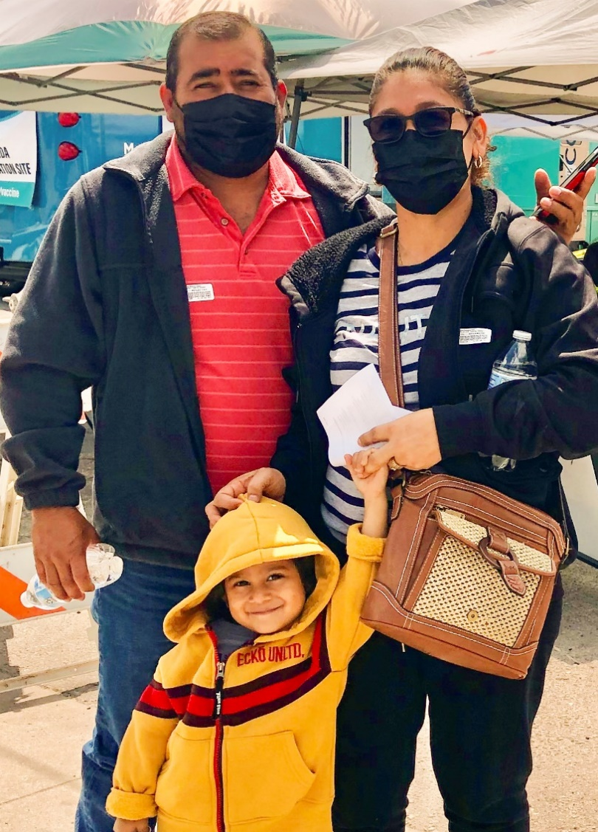
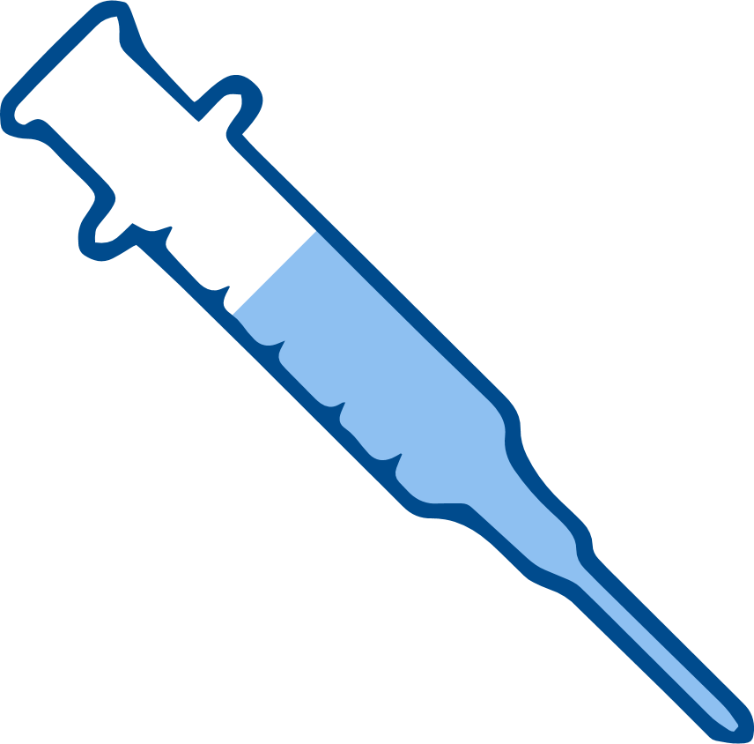
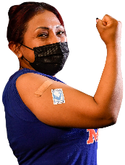
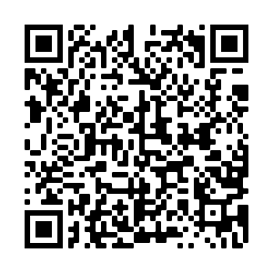
2
Include information on local vaccination efforts
Use the top portion back cover of the brochure to provide resources and links out to more information on vaccination in the area.
The text on this panel is completely editable and new text can be added by right clicking on the border of a text box → selecting copy from the menu → right click where you want the new text box → select Paste from the menu
1
COVID-19 VACCINES ARE SAFE AND EFFECTIVE
HOW DO I GET A COVID-19 VACCINE?
Add an image and scale it
Go to Insert → Image → Upload from Computer and select an image of you that you’d like on the brochure cover.
To scale, grab bottom right corner of image and hold the clicker down. Drag your mouse or finger across diagonally until it’s the same size/slightly bigger than the slide.
Send your image back
Once you size your image and scale it proportionally to the size of the slide or slightly bigger, right click on the image and go to Order → Send to back
Crop your image
If the image is larger than the brochure cover, you can crop it by right clicking on the image and selecting the Crop tool that appears in the pop-up menu. You can then drag the black bars at the edges of the image to trim it to the right size. Click outside of the image to apply the changes.
Types of vaccines available in the US:
Pfizer
Moderna
Johnson & Johnson (J&J)
Contact your local health department to make an appointment or ask them where mobile vaccine clinics are located.
Check with your local pharmacy. They will likely offer vaccines.
Contact your local community health center to make an appointment.
Speak with your employer about getting a COVID-19 vaccine. They may be helpful in making arrangements to get a vaccine.
Get your initial doses now. Full protection kicks in after about two weeks. A booster or an additional dose is needed several months after completing your initial doses.
RECOMMENDATIONS
Get vaccinated. Get boosted.
Get your family vaccinated and boosted.
Pfizer or Moderna are recommended when there is a choice.
Wear a mask when indoors even when you are up to date on your vaccines. And wear a mask in crowded outdoor settings.
If you are up to date on your vaccines and are exposed to COVID-19 follow CDC guidelines and get tested 5-7 days after exposure.
FOR MORE INFORMATION
For answers to Frequently Asked Questions, visit Migrant Clinicians Network (MCN): https://bit.ly/3ki1xAI
For
women:
GET VACCINATED!
Wear a mask
Social distancing
Wash your hands
For women who are pregnant, breastfeeding, or trying to get pregnant, vaccines are critical for keeping moms and their babies healthy.
For women between 18-60 years old, we recommend getting Pfizer or Moderna.
Updated on: January 6, 2021
COVID-19 Vaccine Awareness Campaign
3
Add information on your organization and other relevant resources
The bottom portion of the back cover allows you to include organizational links, phone numbers, and other information useful to your community.
Be sure to include a date on the brochure as information changes quickly.

Slide 2
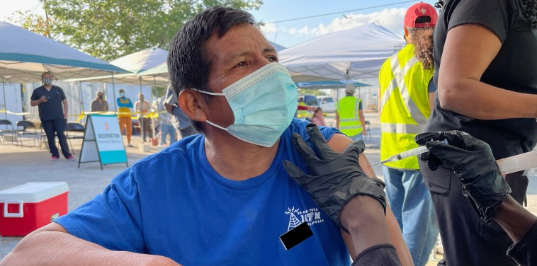
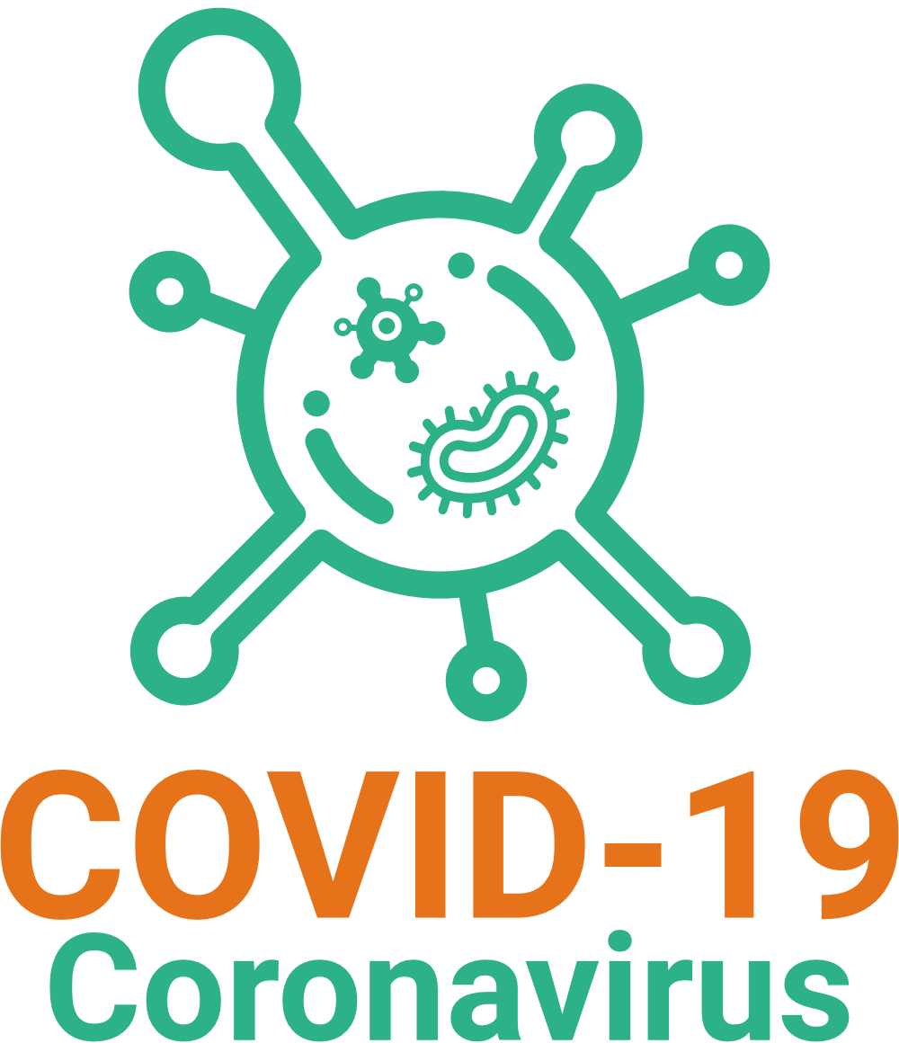
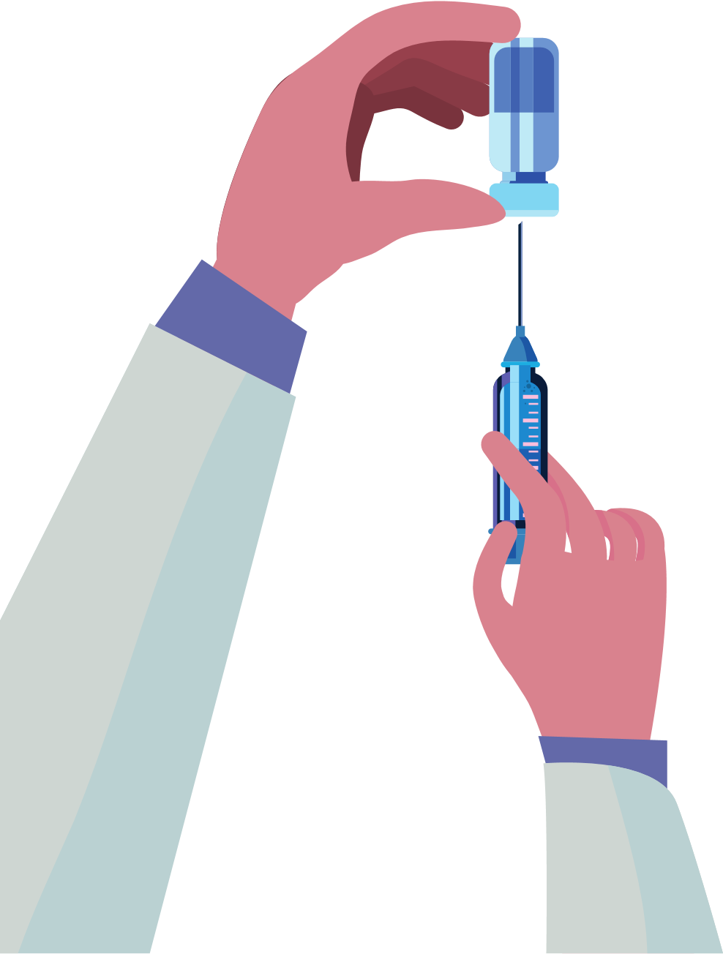
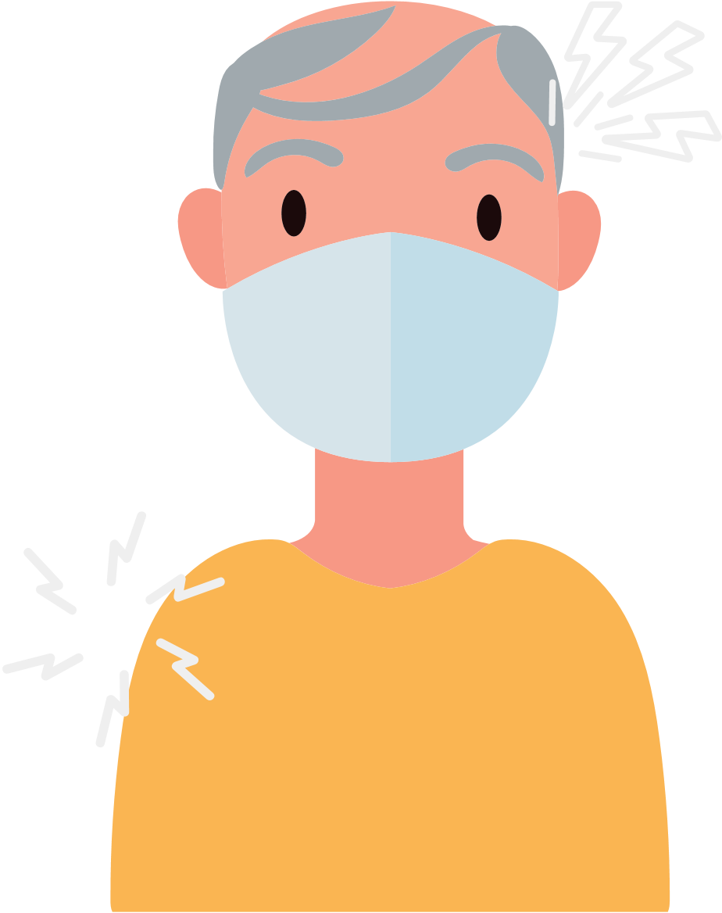
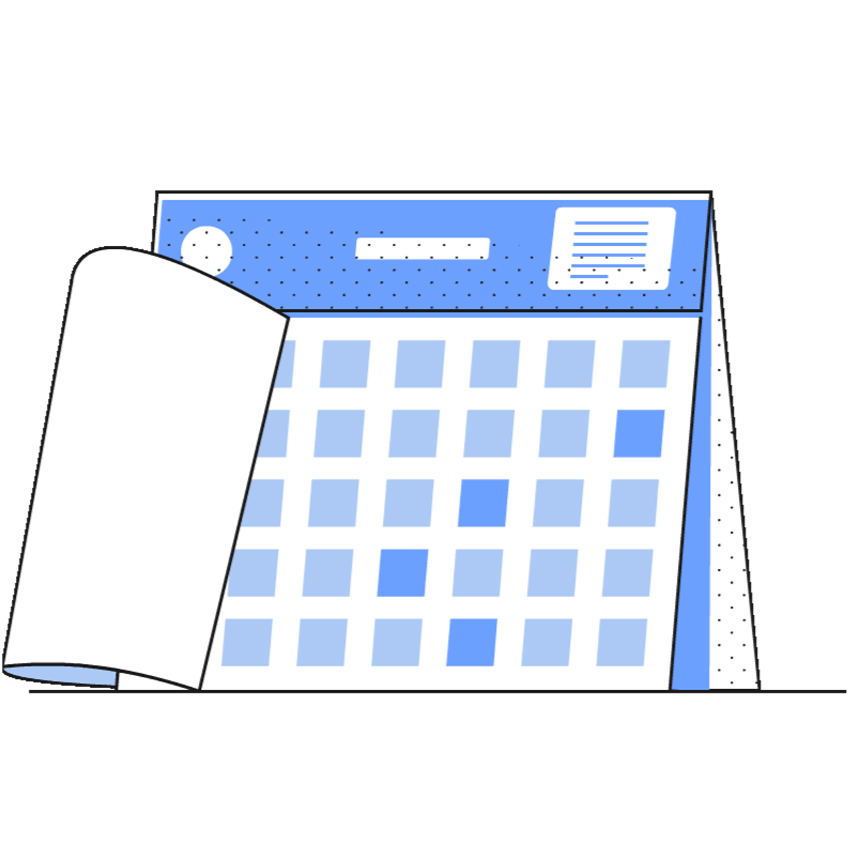
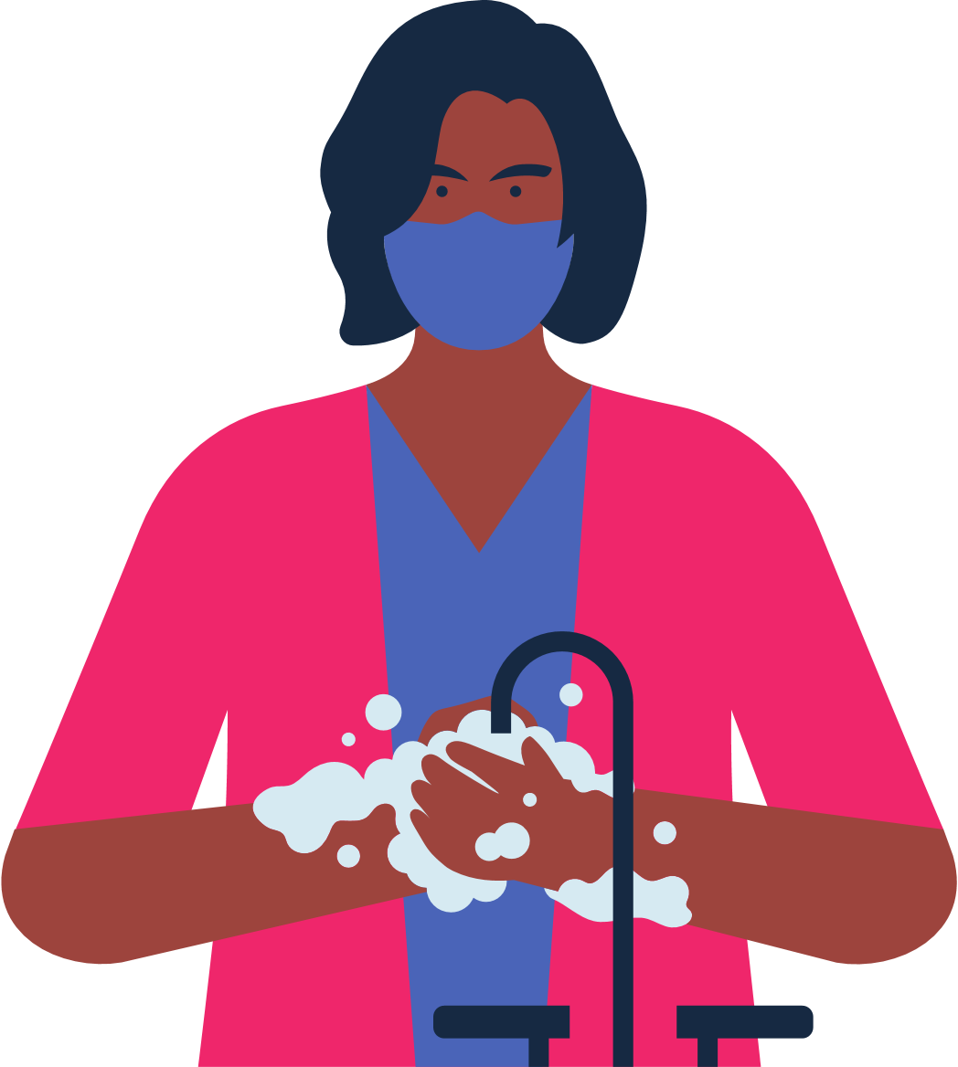
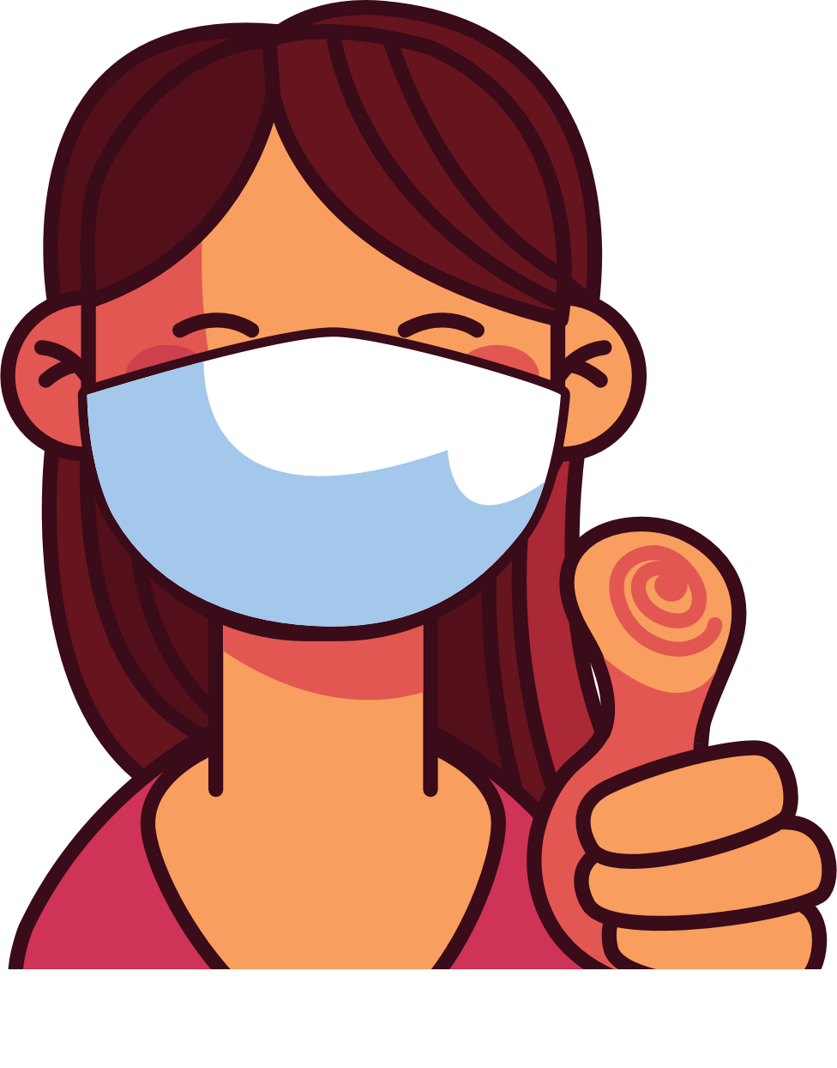
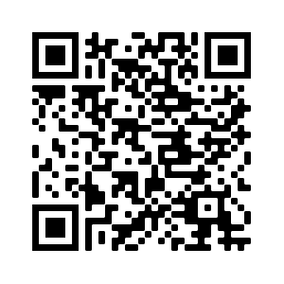
4
Address Concerns in the Community
This panel is intended to provide information addressing the concerns specific to the community receiving the brochure.
The text boxes with the questions and answers can be edited, copied or deleted so you can customize this panel to fit your needs.
Here you can include links to relevant resources or more information addressing the community’s concerns.
WHAT TO EXPECT AFTER YOU ARE VACCINATED?
HOW DO I KNOW WHEN OR IF I NEED ANOTHER DOSE OF THE VACCINE?
Immunocompromised individuals need additional doses of the vaccine.
A booster dose is now recommended several months after receiving your initial dose.
Check for latest updates about boosters.
BENEFITS TO VACCINATION
It is important to get vaccinated, even if you have had COVID-19.
It is completely FREE and does NOT require any form of identification.
Vaccination protects you, your family, and your co-workers from becoming seriously ill and being hospitalized.
Vaccination decreases the number of new, severe and deadly COVID-19 cases in your community.
Vaccination protects hospitals and clinicians from being overwhelmed with patients severely ill with COVID-19.
The more vaccinated individuals in our community, the less we need to worry about new variants.
We can return to normal activities sooner if more people get vaccinated.
WHAT SHOULD I DO IF I RECIEVED MY FIRST DOSE IN A DIFFERENT COUNTRY AND IT IS NOT AVAILABLE IN THE U.S?
There are various types of vaccines. All vaccines against COVID-19 are safe and effective.
After vaccination you may experience: arm pain, headache, fever, or chills.
Not all countries have approved the same COVID-19 vaccines as the United States.
If you have received one dose of any COVID-19 vaccine that is not approved in the United States, then you may be eligible for a Pfizer, Moderna, or J&J vaccination. To receive a new vaccine you must wait at least 28 days after your last dose.
5
Save the file as a PDF
Once the content of the brochure has been finalized, you can save the file as a PDF for printing and distribution.
Export as a PDF using PPT:
Select slide. File → Save As Adobe PDF
Export as a PDF using Google Slides:
File → Download → PDF Document
RISKS FOR UNVACCINATED
You will feel better a few days after your injection.
You are considered fully vaccinated two weeks after your final dose.
Higher risk of COVID-19 infection.
Higher risk of serious infection, hospitalization, and death.
If a majority of individuals DO NOT get vaccinated against COVID-19, then there is a larger risk of serious illness and risk of new mutations that are more contagious and dangerous.
WHERE DO I GET MORE INFORMATION?
Visit Centers for Disease Control and Prevention:
www.cdc.gov/coronavirus/2019-ncov/index.html
Continue to wear a mask, wash your hands, and maintain social distance.
You did your part to protect yourself and others from COVID-19!

