Slide 1
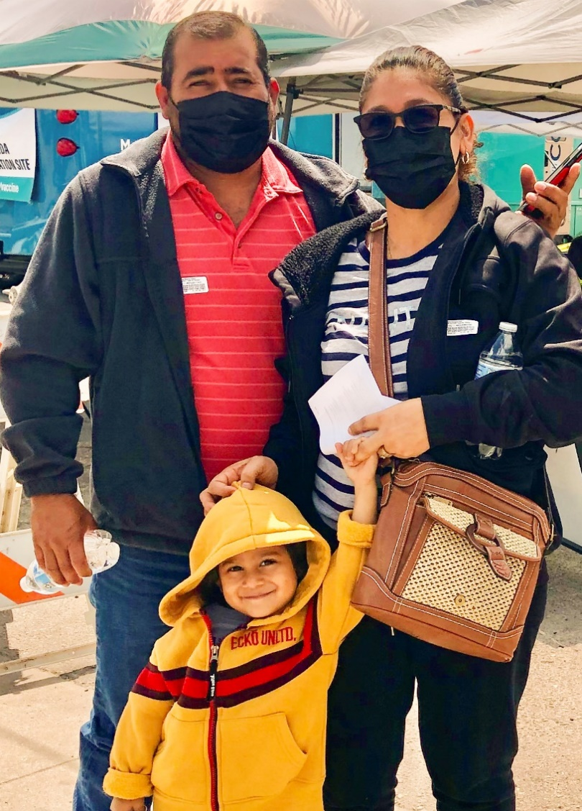
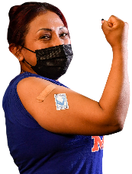
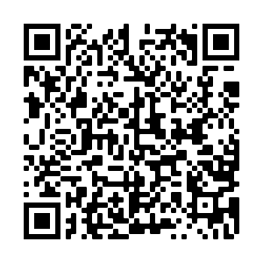
2
Include information on local vaccination efforts
Use the top portion back cover of the brochure to provide resources and links out to more information on vaccination in the area.
The text on this panel is completely editable and new text can be added by right clicking on the border of a text box → selecting copy from the menu → right click where you want the new text box → select Paste from the menu
1
VAKSEN KONT COVID-19 YO SAN DANJE EPI YO EFIKAS
Kòman mwen kapab jwenn Vaksen kont COVID-19?
Add an image and scale it
Go to Insert → Image → Upload from Computer and select an image of you that you’d like on the brochure cover.
To scale, grab bottom right corner of image and hold the clicker down. Drag your mouse or finger across diagonally until it’s the same size/slightly bigger than the slide.
Send your image back
Once you size your image and scale it proportionally to the size of the slide or slightly bigger, right click on the image and go to Order → Send to back
Crop your image
If the image is larger than the brochure cover, you can crop it by right clicking on the image and selecting the Crop tool that appears in the pop-up menu. You can then drag the black bars at the edges of the image to trim it to the right size. Click outside of the image to apply the changes.
Kalite vaksen ki disponib Etazini:
Pfizer
Moderna
Johnson & Johnson (J&J)
Kontakte depatman sante ki nan zòn ou an pou pran yon randevou oswa mande yo ki kote klinik mobil pou vaksen an ye.
Verifye avèk famasi ki nan zòn ou an. Gen chans pou yo ofri vaksen yo.
Kontakte depatman sante ki nan zòn ou an pou pran yon randevou.
Pale avèk patwon ou an sou fason ou kapab jwenn vaksen kont COVID-19 la. Yo ka ede w nan aranjman w ap fè pou pran yon vaksen.
Pran premye dòz ou a kounya. Pwoteksyon konplè a kòmanse fonksyone nan apeprè de (2) semèn. Gen yon vaksen rapèl oswa yon dòz anplis ki nesesè plizyè mwa apre ou fin pran premye dòz yo.
Rekòmandasyon
Pran vaksen an. Pran vaksen rapèl la.
Fè fanmi w vaksine epi pran vaksen rapèl yo.
Nou rekòmande Pfizer oswa Moderna lè ou gen chwa.
Mete yon mask lè ou deyò menm lè ou ajou nan vaksen yo. Epi, mete yon mask nan figi ou lè w nan espas deyò ki gen anpil moun.
Si ou ajou nan vaksen yo epi ou te ekspoze ak COVID-19 suiv rekòmandasyon CDC yo, epi fè tès la 5 jiska 7 jou apre ou te ekspoze.
Pou w jwenn plis enfòmasyon
Pwoteje Tèt ou Kont COVID-19
Pou fi yo:
Pou Kesyon Moun Poze Souvan, ale sou Migrant Clinicians Network (MCN): https://bit.ly/3FyJ6lA
Al pran vaksen an!
Mete yon mask
Distans Sosyal
Lave men ou
Pou fi ki ansent, ki ap bay tete, oswa ki ap eseye ansent, vaksen yo enpòtan anpil pou kenbe manman ak ti bebe yo an sante.
Pou fi ki gen 18 jiska 60 ane, nou rekòmande pou w pran Pfizer oswa Moderna.
Kanpay Sansibilizasyon pou Vaksen kont COVID-19
Mizajou: 6 Janvye 2022
3
Add information on your organization and other relevant resources
The bottom portion of the back cover allows you to include organizational links, phone numbers, and other information useful to your community.
Be sure to include a date on the brochure as information changes quickly.

Slide 2
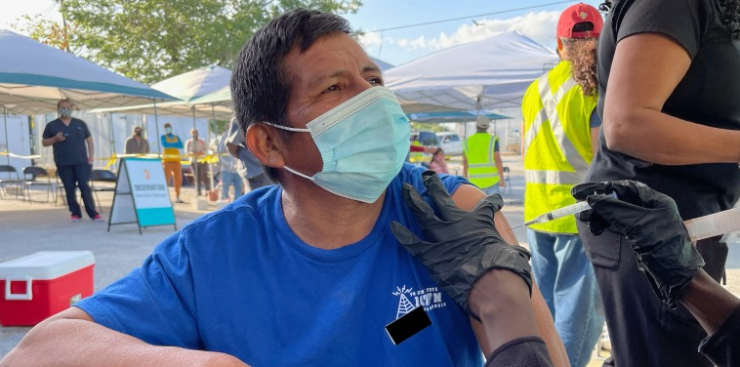
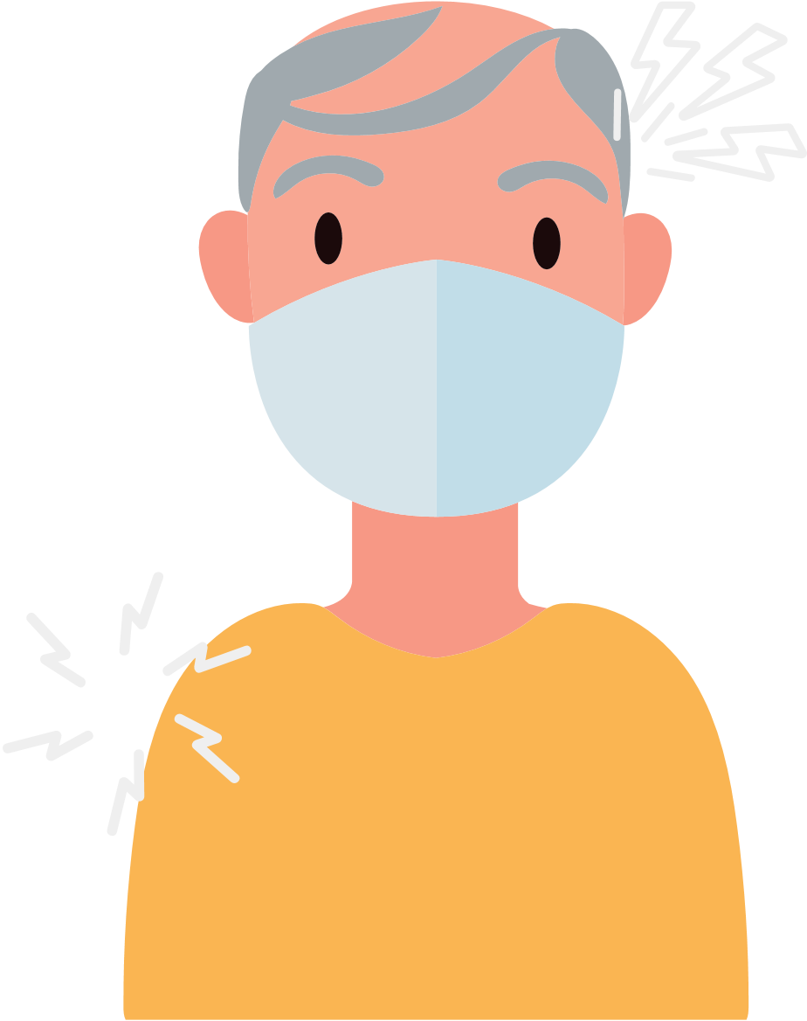
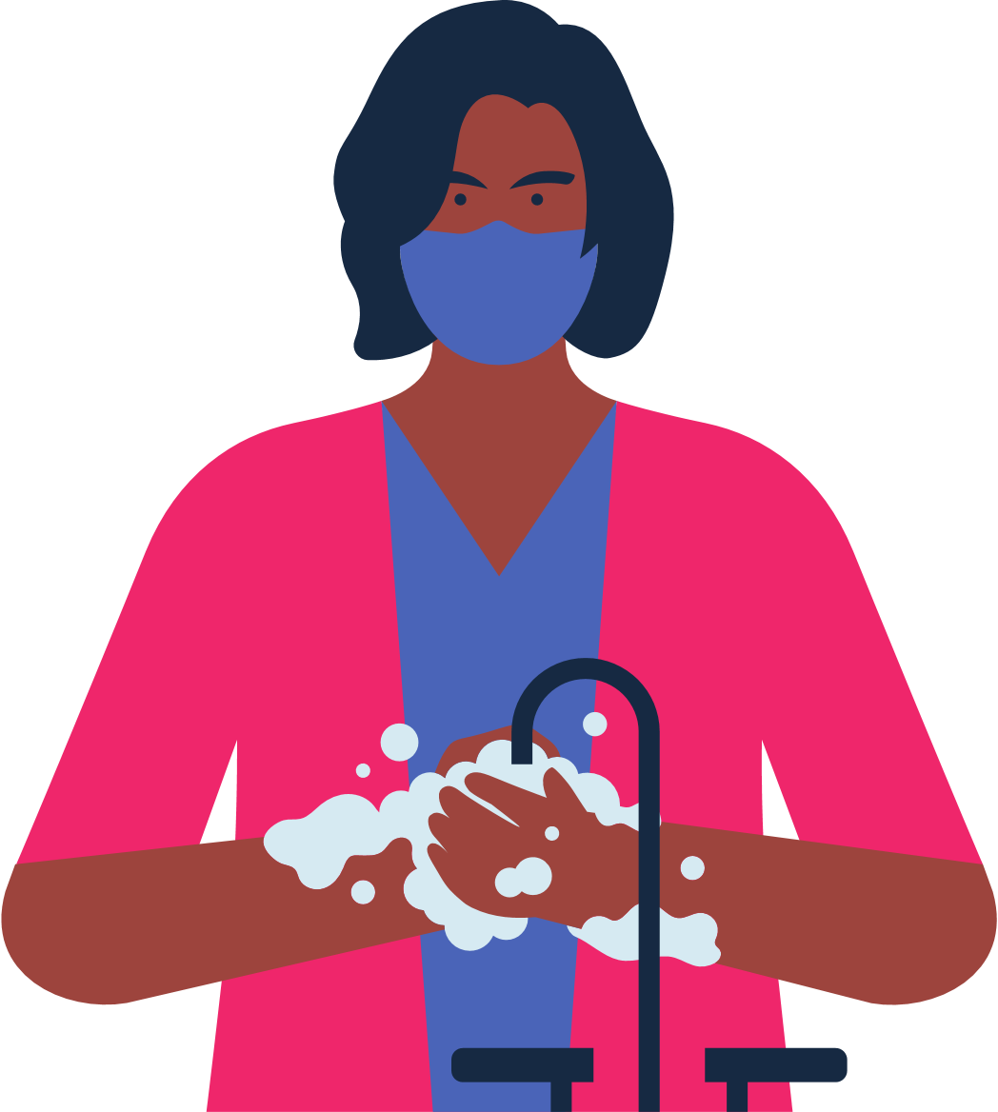
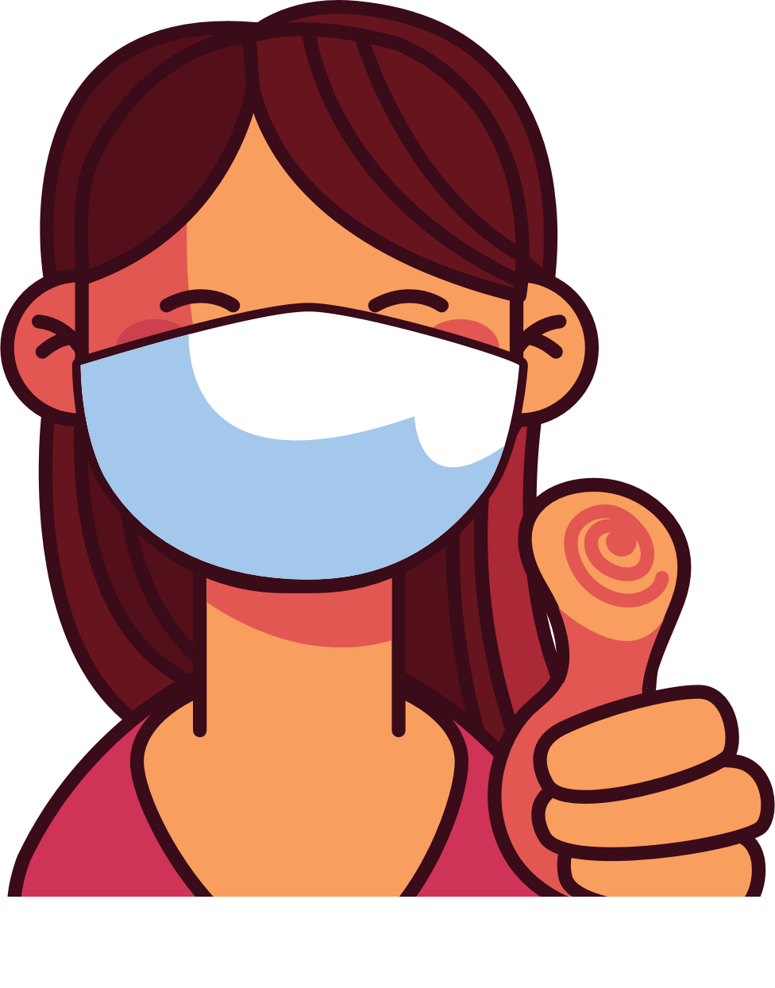
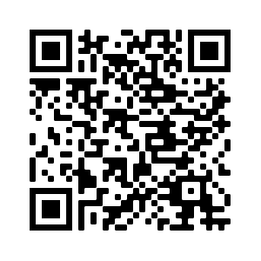
4
Address Concerns in the Community
This panel is intended to provide information addressing the concerns specific to the community receiving the brochure.
The text boxes with the questions and answers can be edited, copied or deleted so you can customize this panel to fit your needs.
Here you can include links to relevant resources or more information addressing the community’s concerns.
Kisa pou w atann aprè ou fin pran vaksen an?
Kòman m ap fè konnen kilè oswa si mwen bezwen yon lòt dòz vaksen an?
Moun ki gen sistèm iminitè ki fèb yo bezwen dòz vaksen anplis.
Kounya yo rekòmande yon dòz rapèl plizyè mwa apre ou resevwa premye dòz ou a.
Verifye pou w kapab gen enfòmasyon sou vaksen rapèl yo.
Avantaj Vaksinasyon an
Li enpòtan pou pran vaksen an, menm si ou te gen COVID-19.
Li GRATIS nèt epi li PA mande okenn fòm idantifikasyon.
Vaksinasyon an pwoteje w, fanmi w, ak kòlèg ou yo kont maladi grav epi pou yo pa entène lopital.
Vaksinasyon an diminye kantite nouvo ka COVID-19 ki grav epi ki tiye moun nan kominote ou a.
Vaksinasyon an pwoteje lopital ak doktè yo pou yo pa plen avèk pasyan ki malad grav avèk COVID-19.
Plis gen moun nan kominote nou an ki vaksine, mwens nou bezwen enkyete pou nouvo varyan yo.
Nan pa twò lontan nou ap kapab retounen nan aktivite nòmal nou si gen plis moun ki vaksine.
Kisa mwen ta dwe fè si mwen te resevwa premye dòz mwen an nan yon lòt peyi epi li pa disponib Etazini?
Gen plizyè kalite vaksen. Tout vaksen kont COVID-19 yo san danje epi yo efikas.
Apre vaksinasyon an ou ka gen: doulè nan bra, tèt fè mal, lafyèv, oswa frison.
Se pa tout peyi ki apwouve menm vaksen kont COVID-19 avèk Etazini.
Si ou te resevwa yon dòz nan nenpòt vaksen kont COVID-19 ki pa apwouve Etazini, ou ka kalifye pou vaksen Pfizer, Moderna, oswa J&J. Pou resevwa yon nouvo vaksen ou dwe tann omwen 28 jou apre dènye dòz ou a.
5
Save the file as a PDF
Once the content of the brochure has been finalized, you can save the file as a PDF for printing and distribution.
Export as a PDF using PPT:
Select slide. File → Save As Adobe PDF
Export as a PDF using Google Slides:
File → Download → PDF Document
Risk ki genyen pou moun ki pa pran vaksen an
Ou ap santi w byen kèk jou apre ou fin pran piki a.
Ou vaksinen nèt de (2) semèn apre dènye dòz ou an.
Ki kote mwen ka jwenn plis enfòmasyon?
Plis risk pou kontamine ak COVID-19.
Plis risk pou gen gwo enfeksyon, entène lopital ak lanmò.
Si yon majorite moun PA PRAN VAKSEN kont COVID-19 la, alò risk pou gen maladi ki grav epi risk pou gen nouvo mitasyon ki pi kontajye ak danjere vin pi plis.
Vizite Sant pou Kontwòl ak Prevansyon Maladi: www.cdc.gov/coronavirus/2019-ncov/index.html
Tanpri kontinye mete yon mask, lave men w, epi kenbe distans sosyal.
Ou fè pati pa w la pou pwoteje tèt ou ak lòt moun kont COVID-19 la!

