Slide 1
Heat-related Illnesses
Notes:
Introduce yourself and the presentation briefly.
Trainer: The PISCA program is supported by the National Institute for Occupational Safety and Health through a grant to the Southeastern Coastal Center for Agricultural Health and Safety. Our primary goal in this project is to help you prevent heat illness. We hope will leave our time together knowing that heat illness, which can be life threatening, is completely preventable. Your experiences and participation will be part of our talk about how you can prevent heat illness, and what you should do if you or someone else experiences heat illness. Let’s get started with a short video…

Slide 2
News from California
https://youtu.be/wsXUGwFEt_U
Notes:
Play the video.
Summarize the main content of the video
Ask participants if they had experience with heat illness.
Wait for participants to answer. Ask more questions to clarify and try to connect it to training if needed.
Trainer: AT THE END OF THE VIDEO- This video shows an extreme case of diseases related to heat - someone died. In Florida, in 2015, there were at least two cases of workers who died while they were harvesting. But heat-related illnesses do not always end in death, another serious case is a permanent disability, and probably many of us have already suffered from diseases, or at least we have been close to having them. For example, many experts agree that the feeling of being thirsty is the first symptom of a heat-related illness.

Slide 3
We will talk about
How can heat-related illnesses be prevented?
What to do if you or someone you know experiences heat-related illness
Why do heat-related illnesses occur?

Slide 4
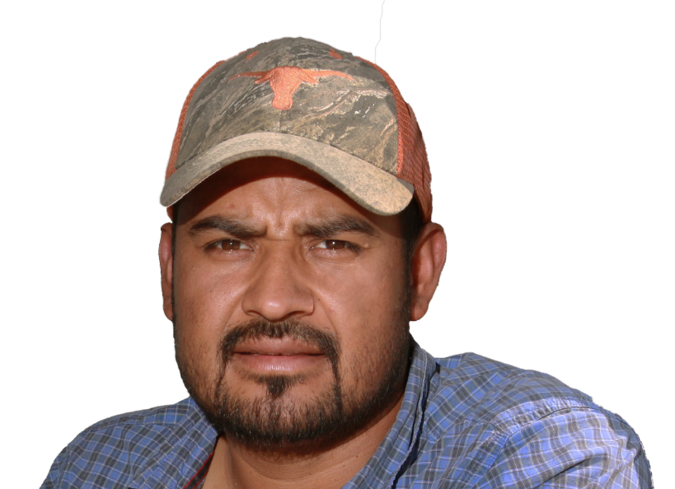
What are heat related illnesses?
Notes:
*Notes: Every brainstorming question slide means you should stop and interact with participants on these questions.
Ask the question on the slide. Allow participants to answer the question.

Slide 5
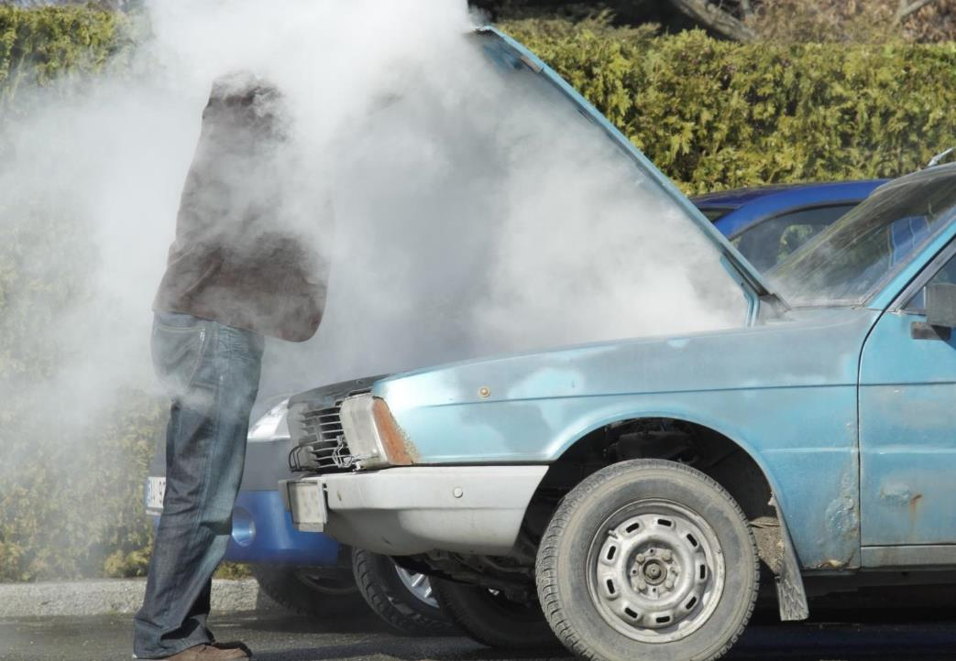
Heat stress is when your body becomes hot to the point where it is unable to cool itself down
Notes:
Take responses from participants. Then make the comparison with the car cooling system.
Trainer: This illustration gives a good picture of heat illness. When a car does not have enough water or oil, or when it is forced to its limits, the car will overheat. The same thing can happen to our body. Just like this car, our body can overheat if we do not have enough water, electrolytes, and we work beyond our capacity. When we are thirsty -- our body is asking for water – our body already knows that we do not have enough water to cool itself down.
Ask participants if the car gives the driver any warning signs of its condition? Allow participants to answer the question.
Make the connection between warning signs from the car and our bodies.
Trainer: If the car had a monitor, like a light in the panel when the car is overheated, the owner may had taken some precautions like adding water. Our body also sends signs when our body is getting too much heat. Recognizing and responding to these signs is what makes health related illness preventable. People should not be dying from heat, or even getting in to the hospital because of heat. Heat-related illness are preventable. If you recognize the illness you can change its effects, decrease its risk, and even be more productive.

Slide 6
Farmworkers packing
Miners
Construction workers
Farmworkers picking
Notes:
Ask participants what occupations are more affected by heat. Allow participants to answer the question.
Show the occupations that are more likely to be affected by heat.
Trainer: Workers from a variety of occupations – especially manual labor jobs that occur outdoors, like mining, fishing, construction, and farmworkers.
But it can also affect indoors workers in hot environments like packing houses, kitchen and bakery workers, and factory workers.

Slide 7
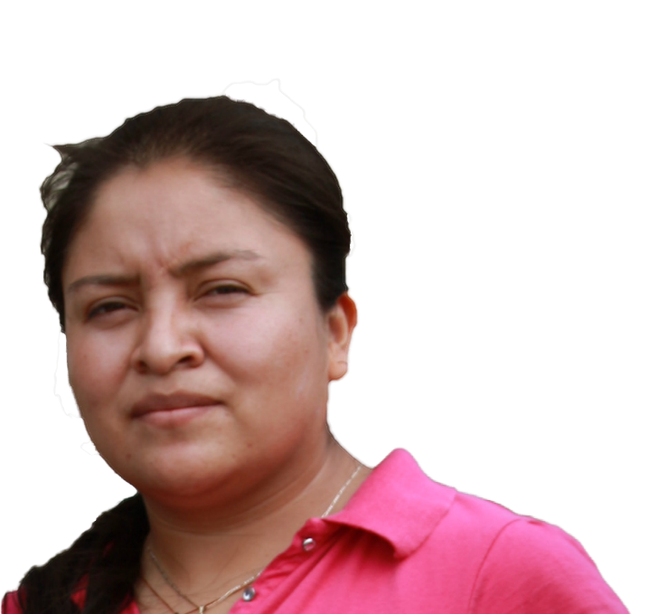
Are farmworkers
in greater danger?
Notes:
Ask the question on the slide. Allow participants to answer the question.

Slide 8
Farmworkers are 20 times more likely to die from heat related illness than other workers.
Farmworkers are 20 times more likely to die from heat related illness than other workers.
Notes:
1) Share the data on the impact of heat illnesses for farmworkers.
Trainer: If you thought that farmworkers are at higher risk for heat related illness, you were right. The U.S. Center of Disease Control found that death rate for heat illnesses is 20-times greater in farmworkers than in the general population.
And when the CDC mentions farmworkers they are referring to workers in any crop, and any part of the operation, which mean from packing workers, to bus drivers, to supervisors, crew leaders, and growers. The workers in the field – those who are planting, weeding or harvesting are most at risk.

Slide 9
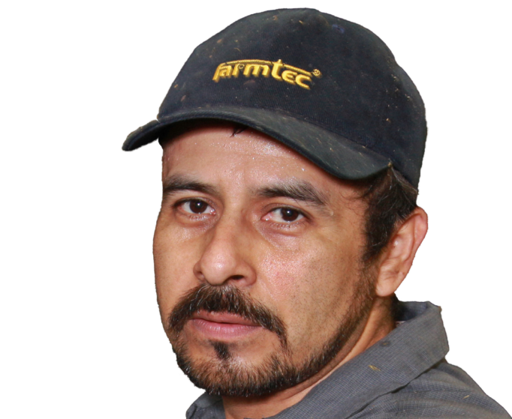
Who is affected by heat?
Notes:
Ask the question on the slide. Allow participants to answer the question.

Slide 10
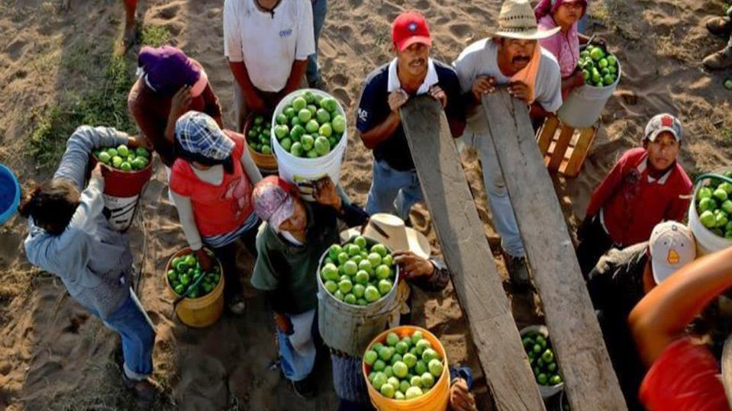
Heat affects us ALL!
Notes:
Point out that every worker is affected even if they are young and healthy.
Trainer: Everybody is affected, men and women, young and old, Mexican, American, Salvadorian, Guatemalan, Canadian…. Especially workers in hot and humid conditions like we have here in southern GA/northern FL is at risk of heat illness, even if you are young and healthy.

Slide 11
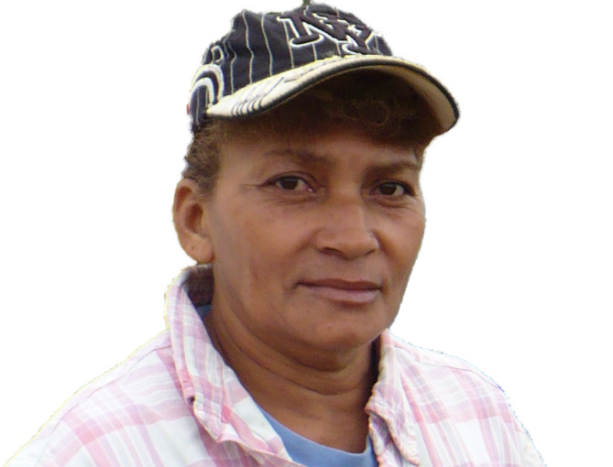
How do our bodies cool down?
Notes:
Ask the question on the slide. Allow participants to answer the question.

Slide 12
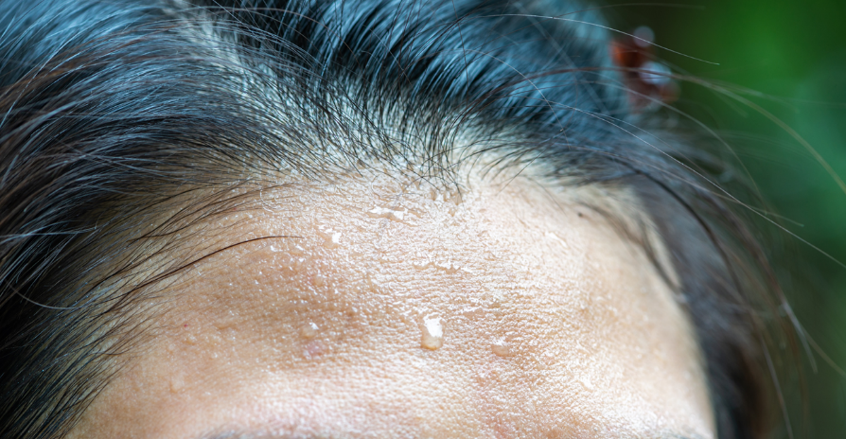
Sweat
Our defense against heat
Notes:
Ask participants how our bodies are responding against heat stress. Wait for participants to respond.
Explain sweating by stressing the following points
Sweat cools your body down when it evaporates.
The more you sweat, the more water you are losing from your body.
Our blood circulation also cools us down, but it is not the main way.
Trainer: Sweating itself does not cool your body – it can‘t because the sweat comes from inside your body; therefore it is the same temperature as your body. Sweat cools your body down when it evaporates. When the droplets of sweat evaporate or dry, it lowers your body’s temperature. This is why heavy clothes or wearing protective equipment can cause your body to overheat --- because they don’t let your sweat evaporate.
Sweat is mainly water – along with electrolytes – so the more you sweat, the more water you are losing from your body.
Our blood circulation also cools us down. Even though circulation is not the main way of cooling the body down, the blood system will do a better job if we have enough water in our bodies.

Slide 13
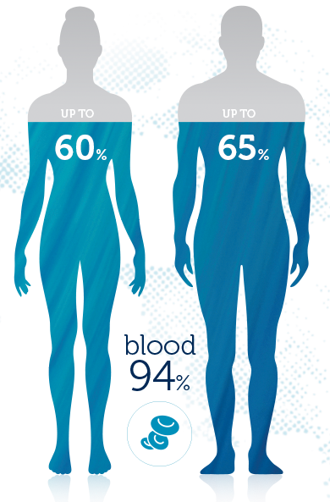
Notes:
Use the previous cases and experiences mentioned by participants to discuss the amount of water in human body
Trainer: Did you know the typical adult human body is 60% water, 20% fat, and 20% proteins and minerals? If we unbalance these percentages our body is going to start sounding an alarm. We are going to talk about what causes you to lose water, and some of the alarm signals that always occur before heat illness.

Slide 14
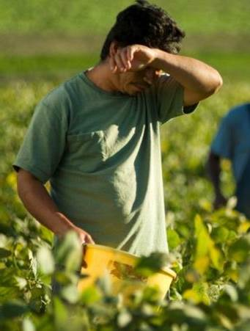
Dehydration
When our body runs out of water
Notes:
Let participants recall the car spewing smoke in the previous slide.
Ask what happened and wait for their response.
Make connections between the car and our body.
If you sweat a lot and don’t replace that water, you will become dehydrated.
Trainer: Let us go back to the car example: what do you think it happen? It is most likely that the car ran out water, right? Perhaps the radiator had a leak, or the owner did not put water in to it for long, long time. Likewise, our body also needs water, our sweating is the leak (similar to an open faucet), and the harder we work the more water we lose.
Have you tasted your sweat? It is salty. The salty taste is from electrolytes; minerals that help our body function. We need them both to prevent heat related illness.
There are many ways to replace electrolytes, many of you drink sport drinks. Those drinks have electrolytes but also a lot of sugar, there are other products like coconut water or even lemon water with a bit of salt that have less sugar. Just remember: those drinks do not substitute drinking water.
Sweating is important for cooling your body down. If you sweat a lot and don’t replace that water, you will become dehydrated.

Slide 15
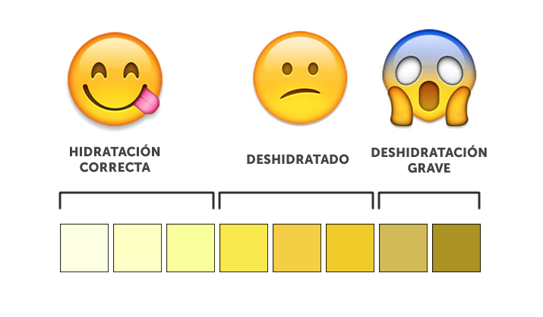
CORRECT HYDRATION DEHYDRATED SEVERE DEHYDRATION
Notes:
1) Point out that the color of urine shows the degree of dehydration
Trainer: A simple way to know how dehydrated this is by the color of your urine. If your urine is very dark it is because your body does not have enough water.

Slide 16
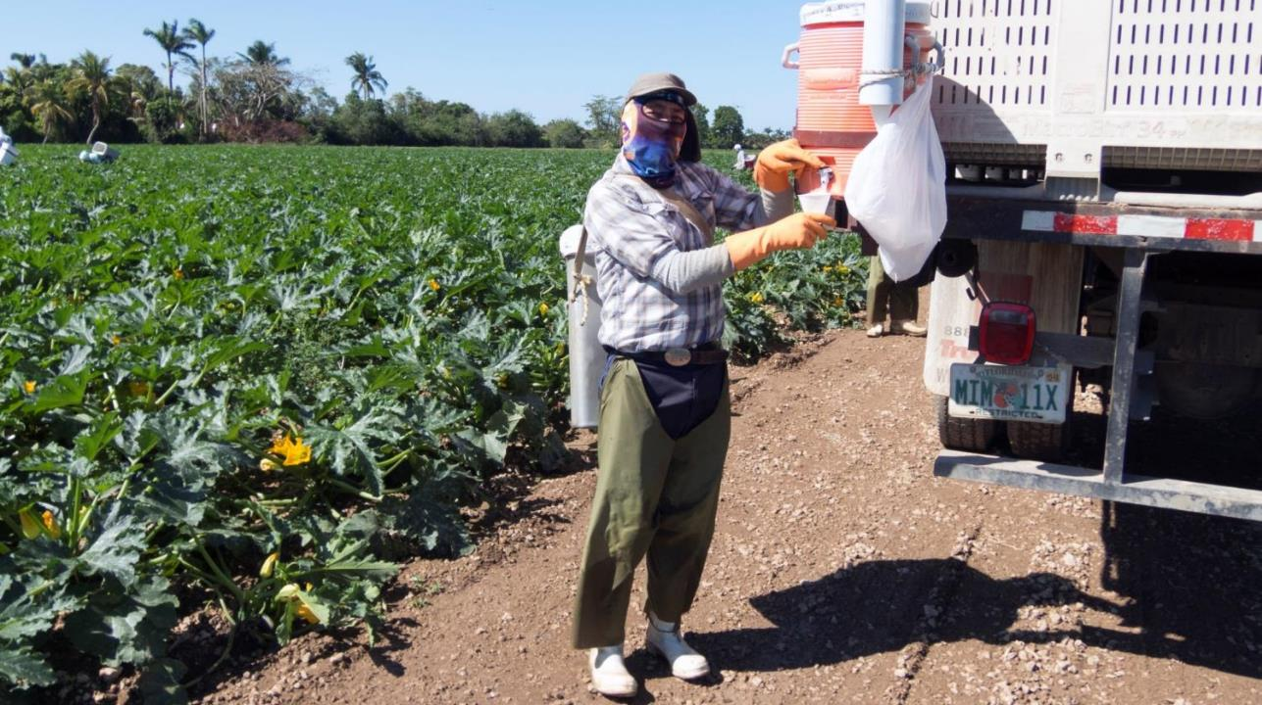
Notes:
1) Point out that drinking water is the most important way of staying hydrated and preventing heat-related illness.
2) Explain the regulations about providing water and bathroom on farms.
Trainer: According with the Occupational Safety and Health Administration (OSHA), the agency at the Department of Labor in charge of regulating and preventing workers injuries, workers should drink 1 cup (250mL) of water every 20 mins when working in the heat. We know this is unrealistic under the working conditions you are facing. However, we want you to have a strategy to have enough water in your body to stand the work you do. For instance, drinking a gallon of water before, during, and at the end of the day may be one strategy.
Although there are no regulations about working in the heat beside states of California and Washington, OSHA will investigate any heat related illness in which the workers ends up at the clinic or hospital. Workers, according with this agency, should have access to drinkable water, disposable cups, and time to access this water. However, they do not conduct inspections in farms, but when someone get sick, they will investigate. If you get sick, your employer has to provide health care but may not cover for your incapacity.
Federal regulations, like the workers protection standard, or WPS, also require water in the field and bathrooms. Bathrooms, the regulations said, should be at reasonable distance and cleanness. They should have sanitary paper, and a place to wash your hands before and after going to the bathroom. We know that many farmworkers avoid going to do their needs for working reasons, but also because there are no bathrooms, or they are dirty.
If you do not have access to water and bathrooms complain, you are in your right! Try to complain in group, so they listen to you.

Slide 17
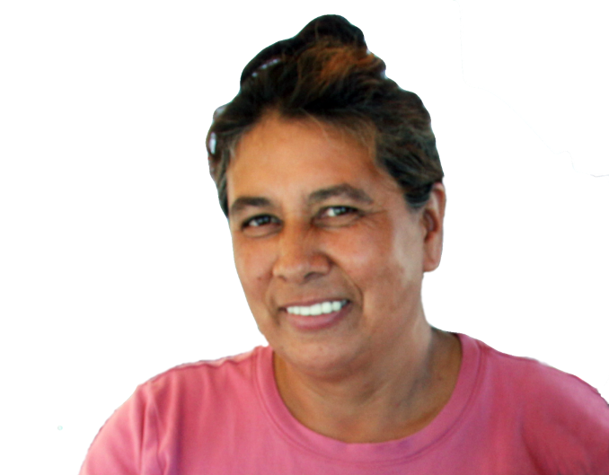
Why do farmworkers sweat so much?
Notes:
Ask the question on the slide. Allow participants to answer the question.

Slide 18
Ambient Heat
Heat from Exertion
Notes:
Categorize participants’ answers into environmental and exertional heat.
Trainer: All the ideas you shared can be put into two basic categories. Farmworkers sweat a lot because they are exposed to heat or conditions that make cooling down difficult, and because they work hard. Or, two forms of heat contribute to why farmworkers sweat so much: environmental heat, and the heat produced by our bodies to perform work or exertional heat.

Slide 19
Environment
Environmental factors
Temperature
Humidity
Shade
Wind
Notes:
1) Ask participants the meaning of “environmental heat”. Allow participants to answer the question.
2) Explain “environmental heat” through temperature, humidity, air movement.
Trainer: Environmental heat refers to several things. Today we are going to focus on three things that are all related to the weather.
First, there is temperature or the measure of how hot or cold it is. In most of the countries in the world temperature is measured in Celsius to mark the temperature, but in the United States temperature is measured in Fahrenheit. 50 degrees Fahrenheit is the 10 degrees Celsius; 68 degrees Fahrenheit is 20 degrees Celsius, and 86 degrees Fahrenheit is 30 degrees Celsius.
Although a thermometer will tell you the current temperature, the effects of the temperature of your body is greatly affected by other weather conditions like humidity. For instance, some of you may had heard a weather specialist saying the temperature is 85 degrees Fahrenheit, but it feels like 90. What does this mean?
Humidity is an important factor of heat. The more humid it is the more heat it creates in your surroundings. That is why it counts for the 5 degrees difference in the previous example.
Air movement is another factor that determines how much farmworkers sweat. You know, buildings used to have high ceilings, and in many of our countries our air conditionings are fans or open windows. These fans and open windows allow the air to move. The more the air moves the more refresh it feels because it helps your sweat evaporate more quickly. That is why working in some crops like corn fields with tall stalks or working in greenhouses feels hotter – there is less air movement.
Environmental heat refers to conditions that make it harder for your body to release heat…things like
■ External temperatures
■ High humidity
■ Little wind/breeze
■ Little shading
*Feel free to use the following example if time allows. （When I was a kid, I went to the soccer games in Zacatepec, Mexico, it is a place under sea level. They always play at noon, and before the game they water the field. The players on that team train under the same circumstances every day, but the visiting team did not. What do you think it happen in the compensatory time? The other team was exhausted before the end of the match.
Humidity makes your body overheat because it makes it harder for your sweat to evaporate. Remember, earlier I explained that sweat itself does not cool you down – when the sweat evaporates or dries it brings down your skin temperature. Well, when there is a lot of moisture in the air –and that is what humidity is – it stops your sweat from evaporating. If sweat doesn’t evaporate, your body’s cooling system will not work well.）

Slide 20
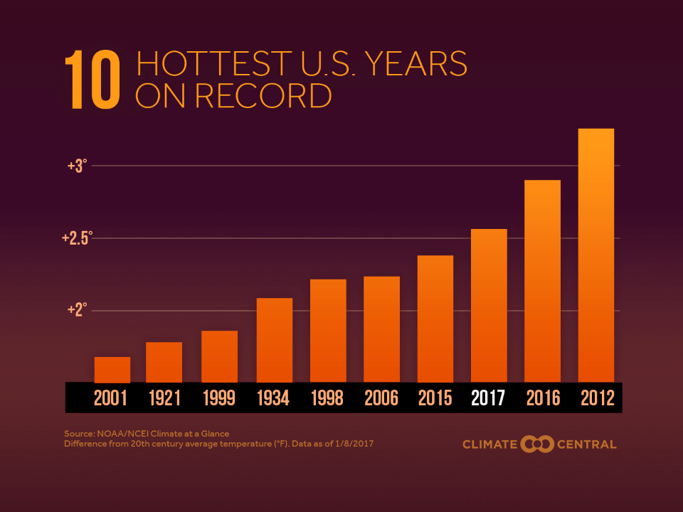
¿El trabajo al aire libre se ha incrementado?
The 10 hottest years in history
Notes:
1) Explain the increased risk of heat stress through global warming.
Trainer: You may have heard people talking about global warming. This slide talks about that. Today’s temperature is 3 degrees Fahrenheit hotter than in the past. This graph shows temperatures changes from 1890 to 2020 – The temperature has been increasing over time, supports the point of environmental heat. Even though one might be working in the fields for 10 years, you are more susceptible to heat illnesses today than 10 years ago because the temperature is hotter.
Climate change has made humans more vulnerable. Everybody is at risk of heat stress, particularly those expose to high temperatures.

Slide 21
Heat from Exertion
Notes:
1) Ask participants the meaning of “exertion heat”. Allow participants to answer the question.
2) Explain “exertion heat” through examples.
■ Exertion heat refers to the rise in body temperature resulting from your work.
Trainer: Just like an engine heats up while it is running – thereby requiring a radiator to cool it down – your body generates heat when it works. The harder you work, the more heat you generate. For instance, let suppose that you are running a stick shift car and you do not know how to make the changes, so you run it in first the whole time, if you speed the engine is not going to hold, is going to overheat or explode. The same happen with our body, if we are not ready or know at what speed to work we are going to overheat… we may not explode, but our body is going to experience what we see with the car.
Exertional heat means that the harder you work, the more heat you produce. Because you are running around, carrying weight, and bending over you produce more heat. Hence, it is important to stay hydrated so your body can cool down.
1) Ask participants what are some ways that farmworkers create exertional heat in the fields. Wait for responses.
Trainer: The harder you work or the harder the task you are doing, for example:
■ Running instead of walking
■ Rapid hand or arm movements
■ Frequent bending and straightening
■ Overfilling buckets or containers
■ All these generate exertion heat

Slide 22
Heat from Exertion
Excessive and continuous loads
https://youtu.be/CsYLBzUbOQk
Notes:
1) Show the video and state the importance of taking breaks.
Trainer: Let’s see this short video(s) and see if you can tell me who may be generating more heat.
Recent studies had shown that the piece-rate system may increase the risk for heat related illnesses because it encourages a faster pace of work. It also prevents workers from taking water breaks – which is essential to replace water lost by sweating – and rest breaks that help your body to cool down. We understand that your pay depends of how much you are making per day, but you should also be aware that if you burn out, you may be out for a while, and you will not be able to work.

Slide 23
Heat from Exertion
Rapid arm movement
https://youtu.be/CsYLBzUbOQk

Slide 24
What factors can affect heat-related illness?
Notes:
Ask the question on the slide. Allow participants to answer the question.

Slide 25
Personal Factors
Age, weight, and physical condition
Pregnancy
Medical Conditions High blood pressure
Drugs
Notes:
Transition: We already covered the main idea that heat illness is caused by dehydration because farmworkers sweat so much, and that the main reason farmworkers sweat so much is because of environmental conditions and how hard farmworkers work. But there are other physical and health conditions that will increase our risk to the heat.
Ask participants what health factors would put a person at greater risk. Wait for participants to respond.
Discuss some factors and health conditions related to heat illness.
Trainer: These are a few factors and health conditions that can put someone at a greater risk of heat illness: age, weight, pregnancy, past health-related illness, heart conditions, diabetes, and certain medications such as…
Allergy medicines (antihistamines)
Cough and cold medicines
Blood pressure and heart medicines
Irritable bladder or bowel medicines
Laxatives
Mental health medicines
Seizure medicines
Thyroid pills
If you have these, it would be good to talk to your doctor about the work you do and ask whether or not there are any special precautions you need to take.
Go through the four key points listed on the slide.
Trainer:
Age is an important factor because the amount of water we have in our body change overtime. When we are young we have more water, when we become older we have less water, so if we are not well hydrated we will be more at risk to HRI.
Weight is important because the fatter we are the more heat we are going to produce, on the contrary a well fit person may decrease the risk of HRI.
Pregnancy tent to elevate the temperature in the body, which may increase the risk of HRI.
Finally, many medications increase our risk because they will increase the amount of water we have.
Ask participants how to prevent heat stress while working in the fields. Wait for participants to respond.

Slide 26
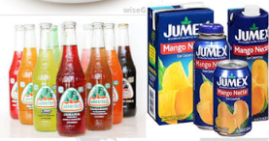
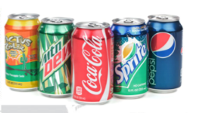
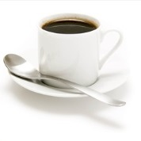
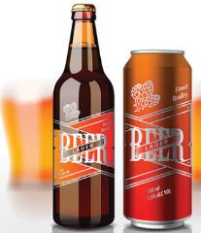
=
Notes:
Ask participants if they drink coffee in the morning.
Explain “diuretic” by using coffee as an example.
Script: Well, the caffeine in coffee is a diuretic. What does a diuretic do? … It makes you excrete water – primarily by increasing how often how much you have to pee! The more you pee the more water you lose, and the more likely you are to get dehydrated. So, if you drink coffee in the morning, drink a glass of water, before and after the coffee to replenish the water you will be losing. The other option is not to drink coffee, and drink just water.
Energy drinks make us feel stronger because they have a lot of caffeine: more than most other drinks. However, because of that caffeine, they are cause you to pee more. Again, if you drink them, drink additional water to compensate for the water you will lose; or just stop drinking them, not just for the caffeine, but because the amount of sugar they have. We will be back to sugar next, but for now:
Ask participants if they know other common diuretics.
Point out that alcohol is another common diuretic.
Trainer: Alcohol is another common diuretic. Think about it, what do you feel when you have a hangover?
Thirst
Headache
Dizziness
upset stomach
Chills
All of these are caused primarily by dehydration. Think about, if drank 10 beers last night – how many times did you go to the bathroom to pee – probably at least 10 times. So alcohol always leaves you more dehydrated: never drink alcoholic beverages in an attempt to replace fluids.

Slide 27
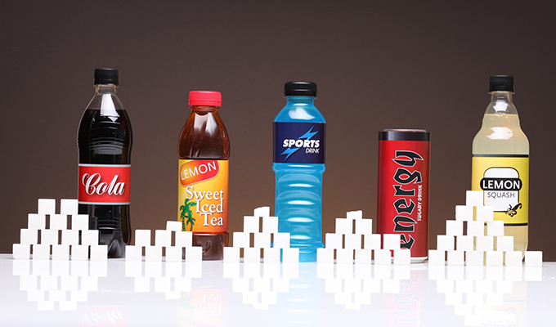
Notes:
1) Explain that sugary beverages will affect how human body deal with heat (Soda, sport drinks, coconut water).
Trainer: Remember what we talk about a good circulation and sweating to control heat. Sugary beverages affect your circulation and increase your desire to go to the bathroom. It is true, water alone may not be enough for your body to stay healthy in the fields. When we sweat we are also losing electrolytes, just like we talked about it before. And you may be able to get some of those elements on sodas or even beer, but they can also affect how you deal with heat.
The so called sport drinks are a bit better than regular sodas, but they still have good amount of sugar. For example, a can of coke has 10 table spoon of sugar, coconut water have 4, and your lemonade will have as much sugar as you please, some people will do their own drink adding a bit of salt to it.
Water, like food, has a process for our body to absorb it. You do not eat and go to the bathroom then, later. The water is the same. The human body can take between 5-120 minutes to absorb all the water and carry it into the bloodstream. The great difference in absorption time is due to different factors. For example, when you have an empty stomach, the water is absorbed in just 5 minutes, but with a stoma, it will take at least 45 minutes.
Finally, I have seen much and more coconut water in stores, that's good, but look at the labels and check that they do not have extra sugar, most of them have, but there are also some that do not have extra sugar in the can.

Slide 28
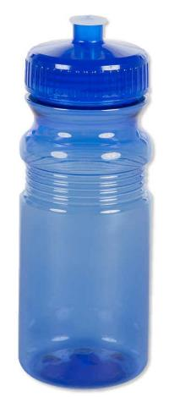
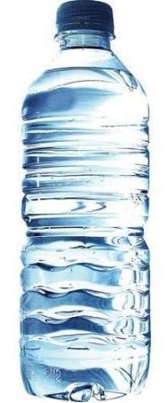
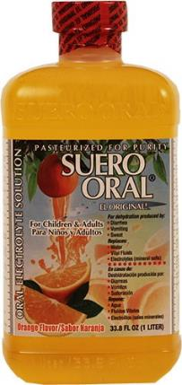
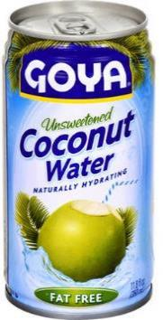

Slide 29
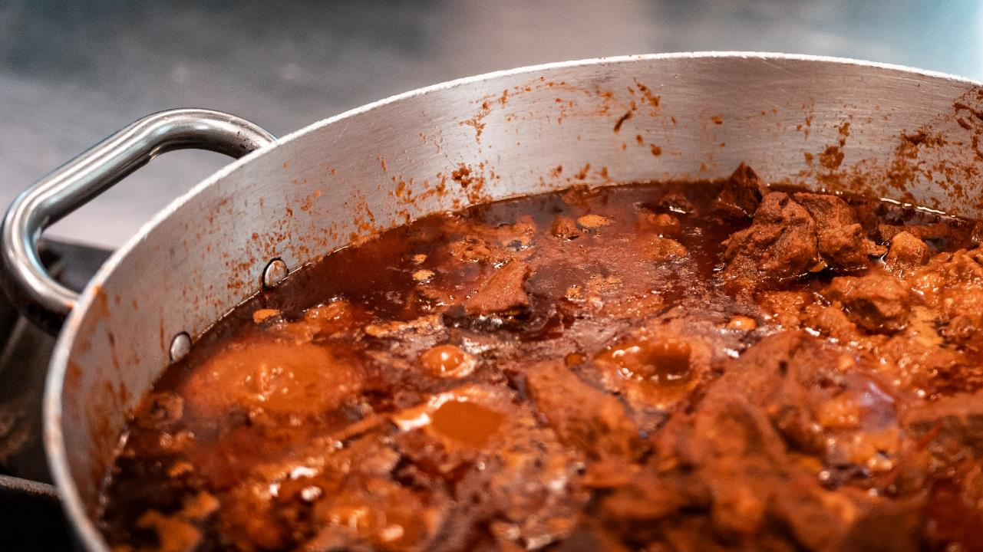
Notes:
Most people don't know that heavy foods add directly to body heat. Heavy meals contribute to overheating of the body in two ways. First, digesting food is work for the body. Therefore, the digestive process creates "exertional heat," due to the work being done. Second, digesting heavy foods is "heavy lifting" - to accomplish that heavy lifting, your body sends more blood to your stomach, which means your blood circulates less and helps less to cool your body.
Trainer: ASK
Can you give us some examples of foods that are difficult to digest, and should be avoided at least during the working day, and some examples of foods that are easy to digest?
WAIT FOR PARTICIPANTS TO RESPOND/ENCOURAGE THEM TO RESPOND
IF NECESSARY, ASK FURTHER QUESTIONS TO CLARIFY
WHEN NECESSARY, SAY POSITIVE THINGS TO PARTICIPANTS
Trainer: TALK ABOUT FOODS NOT TO EAT WHILE WORKING IN THE FIELDS
Fried food, especially if it is breaded, such as milanesa, or fried chicken.
Fatty tacos, such as al pastor, or tripas.
Junk and sugary foods like donuts and sweet breads
Buttery food such as fritangas, mole, tamales, gorditas or popusas.
Your most important meals should be your breakfast, because it is the coolest part of the day, and your chores will help you digest those foods. It may be a good idea to keep your midday meal light and fresh. Try to rest for a while after eating. Once your workday is over, you can eat a little heavier.
We know that many of you don't have time to cook until you get home from work, so, if possible, try to cook with less oil and less sugar.

Slide 30
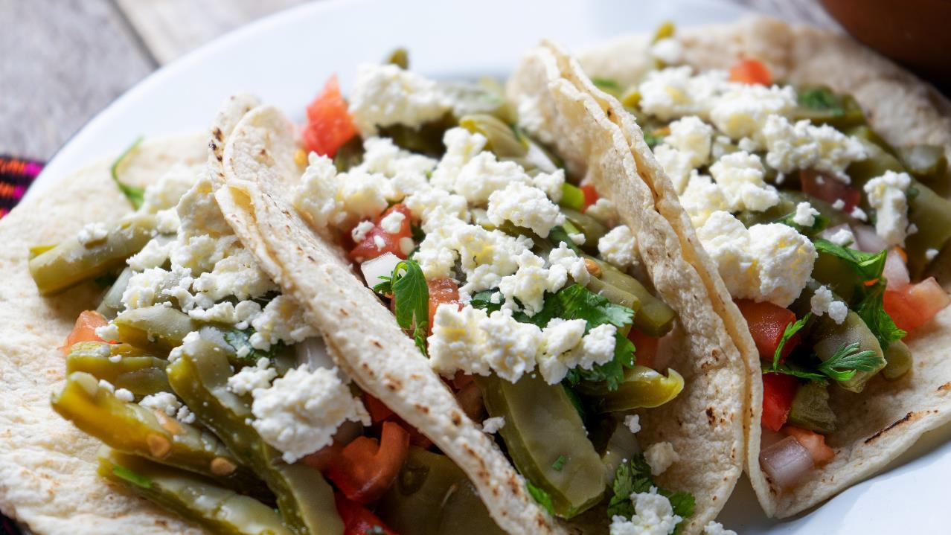
Notes:
An example of healthier food.

Slide 31
Acclimatizing to the heat
Notes:
1) Ask participants if they know the meaning of “heat tolerance” or “acclimation”. Wait for participants to respond.
2) Explain “heat tolerance” or “acclimation” through example.
Trainer: The basic idea is that it takes time for people to “get used” to the heat or the humidity, or it takes time for people to get used to the type of work that is done in the fields.
Did you remember when I told you the story of the Zacatepec Soccer Team? The players of that team were used to play under very hot conditions. Their body was acclimatized to the heat, while the visiting players were not. Our body, like the body of that pinging may not be used to the heat of the desert. Acclimation is the process by which you become physically adjusted to the temperature of your environment.
3) Stress the following main points
■ Individuals who aren’t used to heat, must be extra careful.
■ No heat tolerance = higher risk for heat-stress.
■ Humans get used to the heat within 4 to 14 days. But they can also lost their acclimatization as quick as in 2 days.
■ Pay special attention to new and returning workers.
4) Point out the following groups that need to be extra careful.
■ New employees
■ People just back from being sick
■ Anyone absent for more than 2 weeks
■ People who have just moved from a cooler climate

Slide 32
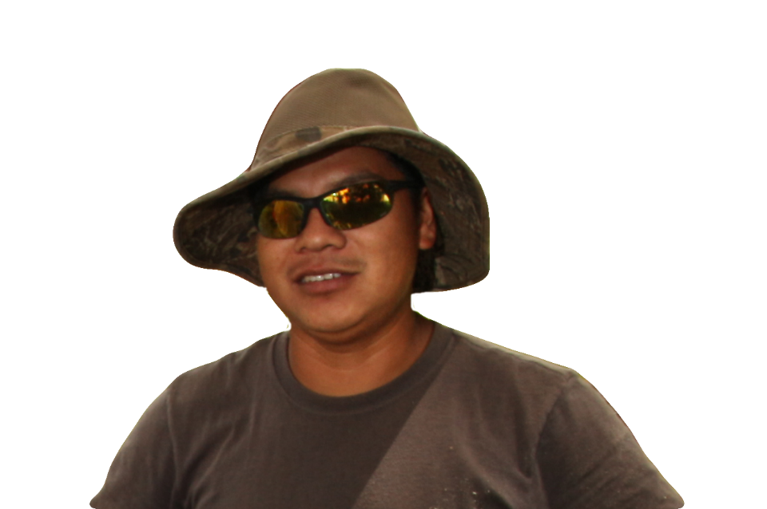
How can you protect yourself while you're working?
Notes:
Ask the question on the slide. Allow participants to answer the question.

Slide 33
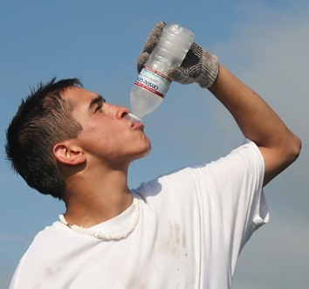
Water
Water
Notes:
1) Stress the importance of drinking water.
Trainer: The key idea for preventing heat illnesses is to drink water. There is really no such thing as drinking too much water – so don’t hold back on drinking water.
We understand that some of you have suffered or have seen others suffer from dizziness or vomiting from drinking lots of water. It's not that the water makes them sick, it's that a lot of water without electrolytes causes the body to lose salts. Many of you do not want to drink a lot of water because they go to the bathroom, it is better to lose a little time, than to get sick from the heat. Sweating could reduce the urge to go to the bathroom.

Slide 34
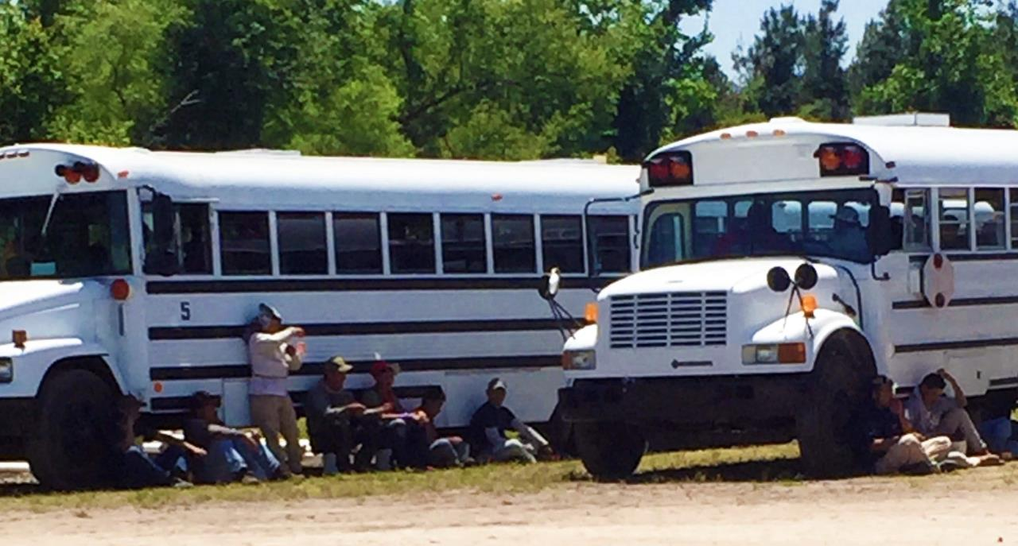
Stop working and rest in a cool place

Slide 35
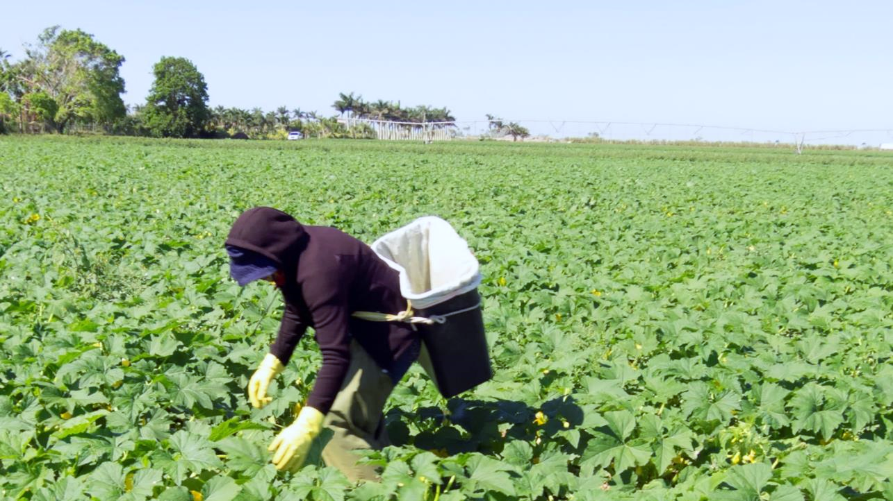
Is this worker at risk?
Notes:
Point out the proper clothes that farmworkers should wear to prevent heat stress.
Trainer: Finally, farmworkers can prevent heat stress and related illnesses by being attentive to the clothes they wear while they are working
Ask participants what they think about this worker’s clothes? Wait for participants to respond.
Discuss the worker’s clothes.

Slide 36
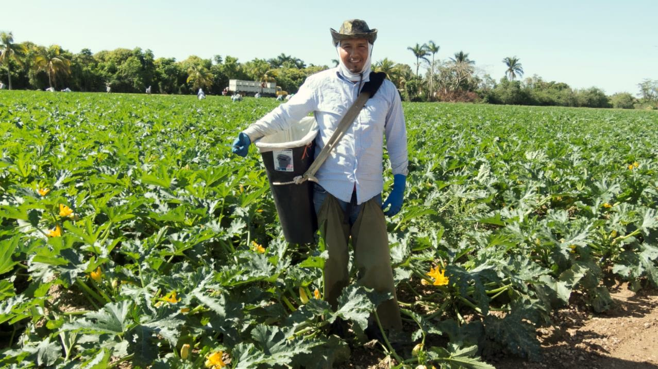
Dressed for the heat
Notes:
Discuss the worker’s clothes.
Trainer: OSHA recommends, that field workers should wear light-colored, light-weight clothing and a wide brim hat to prevent heat-stress.

Slide 37
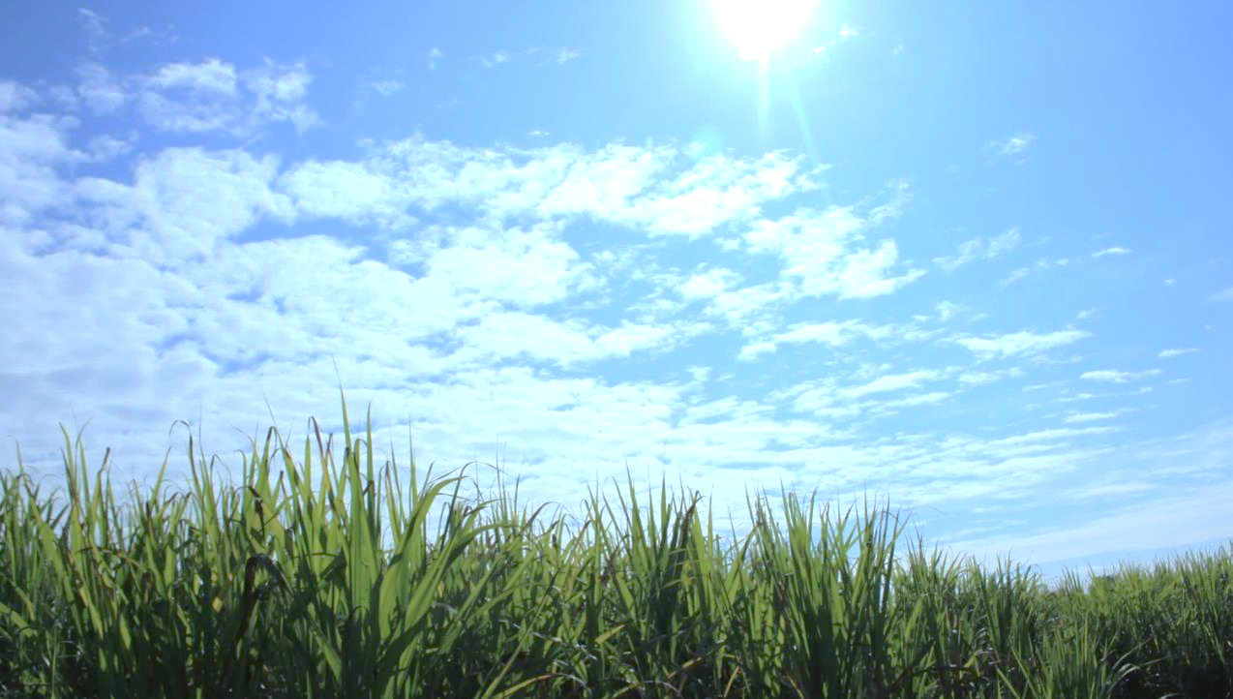
Symptoms of heat-related illness
Stroke
Exhaustion
Cramps
Notes:
Transition: The last thing we need to talk about today is the signs and symptoms of heat illnesses, and what to do when you spot them.
1) Ask participants what the common signs and symptoms of heat exhaustion are. Wait for participants to respond. Give positive feedback.
Trainer: As a matter of fact, these signs and symptoms can be grouped together in three main ways that we’ll talk about next.

Slide 38
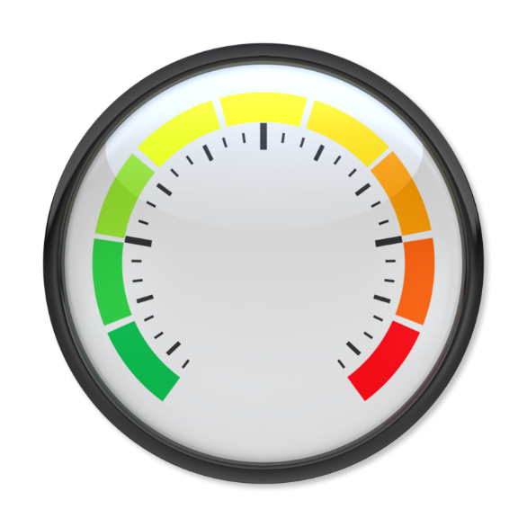
Cramps
Notes:
1. Show the signs and symptoms of heat stress exposure.
2. Start with lower risk to higher risk

Slide 39
Cramps in legs, arms, and stomach

Slide 40
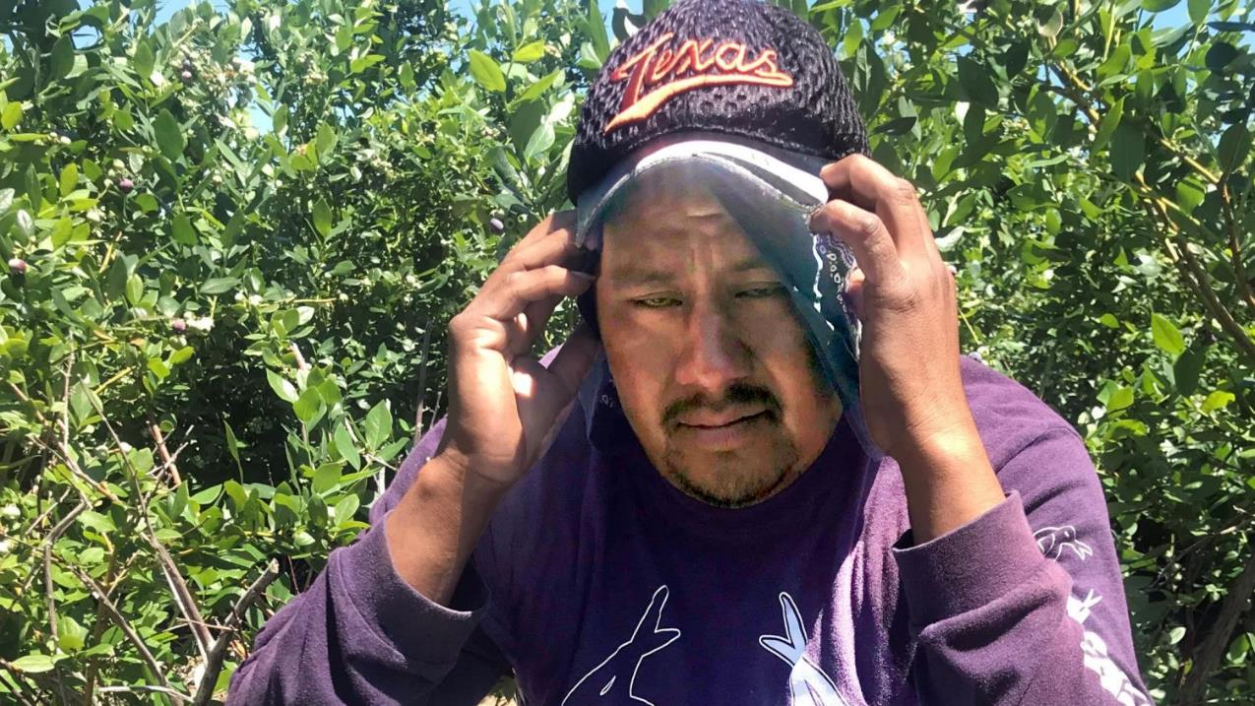
Headache

Slide 41
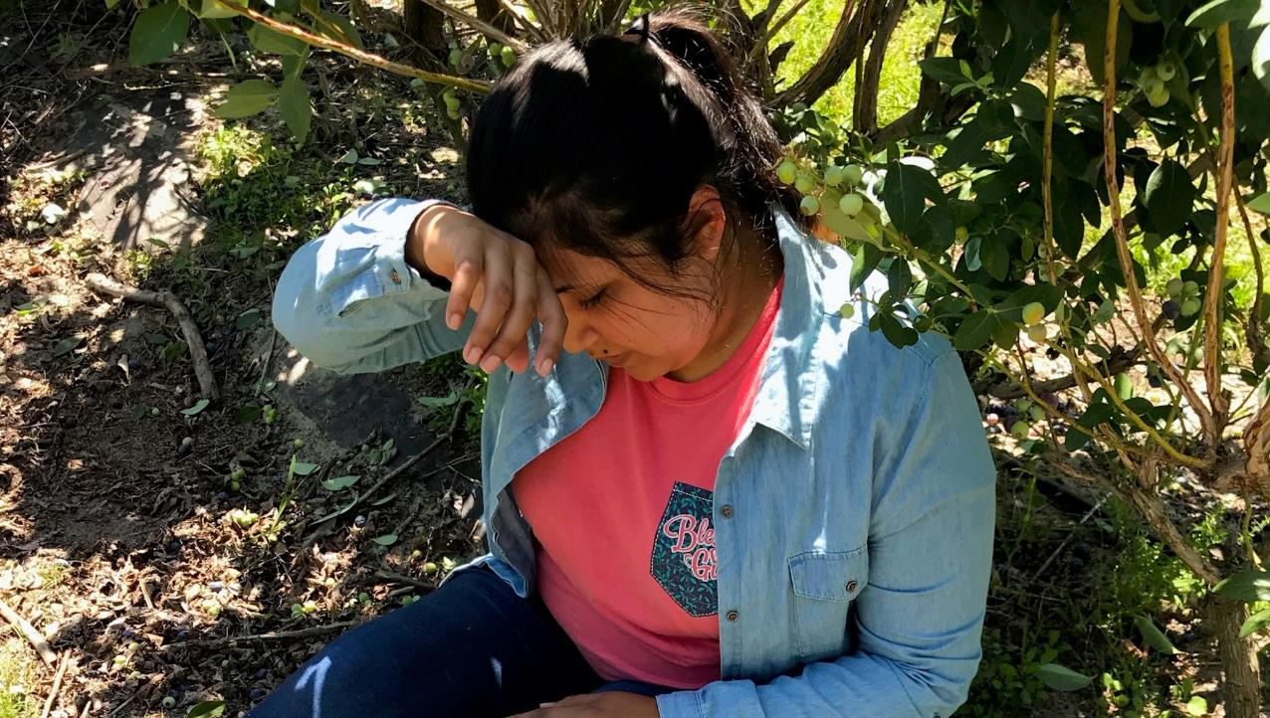
Dizziness
or Confusion

Slide 42
What can be done when someone has signs of heat cramps?
Notes:
1) Ask participants what can be done when someone has signs of heat cramps. Wait for participants to respond.
Recommended answers:
Stop all activities and rest at a cool place
Drink water or sports drink
Stretch and massage affected muscles
If there is no improvement, seek immediate medical help

Slide 43
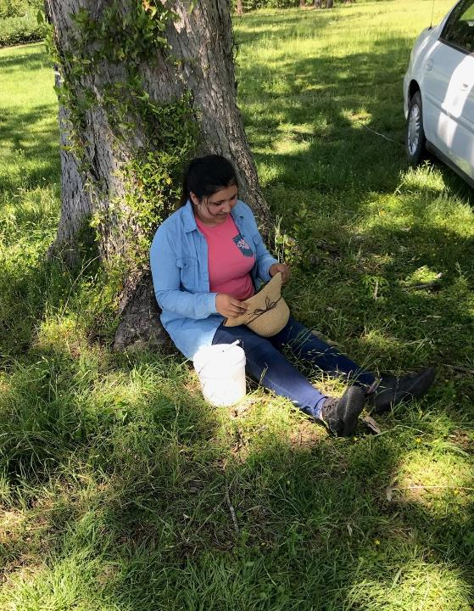
Rest in a cool place

Slide 44
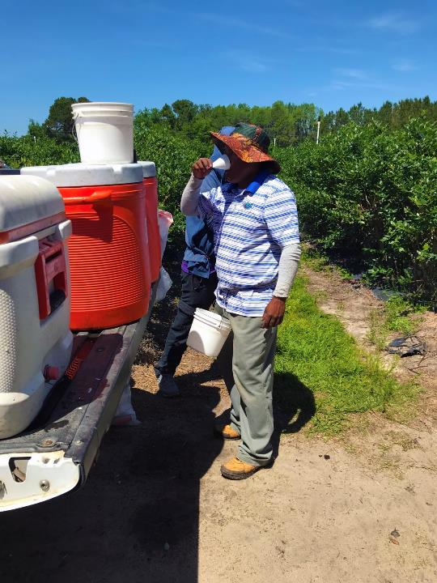
Drink water

Slide 45
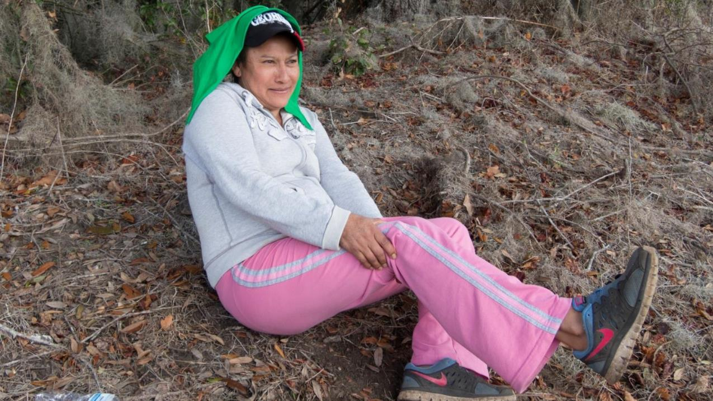
Stretch and massage the affected muscles

Slide 46
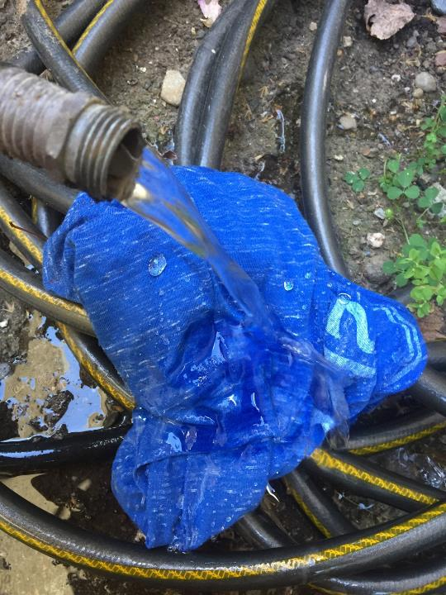
Wet your clothes and use them to cool yourself

Slide 47
Heat Exhaustion
Notes:
We are moving to more serious level of heat related illness

Slide 48
Heat Exhaustion
Headache
Seasickness
Confusion
Rapid heartbeat
Nausea and vomiting
Profuse sweating
Notes:
1) Explain heat exhaustion and the symptoms.
Trainer: The second stage of a heat related illness is the heat exhaustion. Our body has raised the needle to the red section of overheating, the red light is on in the car we saw at the beginning. Symptoms include:
Headache
Dizziness
Confusion
Fast heartbeat
Nausea and vomiting
Profuse sweating
Our body at this stage will go over our normal 37℃ up to 40℃.
Like before it may occur during or after working in the heat, and there is no order in which appear.

Slide 49
What you can do…
Rest
Drink water
Stretch and massage
+

Slide 50
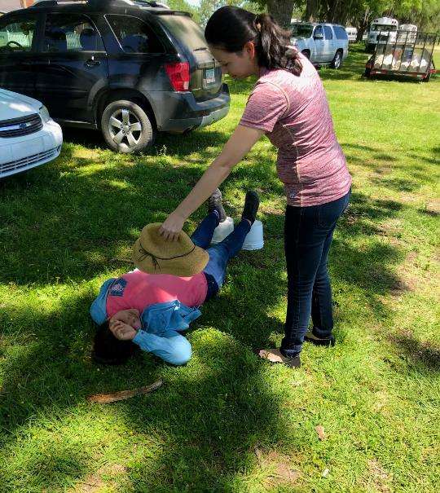
Notes:
1) Present a scenario of a worker suffering from heat exhaustion and ask participants what to do.
2) Explain the proper procedures of helping people with heat exhaustion.
Trainer: If you suspect that the person is suffering from heat exhaustion you should:
Immediately move the person to a cooler location, even on AC rooms. It is true, extreme and sudden changes in temperature from hot to cold can be adverse for the body. However, it is better to have dry skin and eyes, a small cold or muscular pain, than getting into levels of temperature in which you can lose your life or your brain.
● Have them rest lying down and loosen all clothing, especially around the neck, chest, and waist.
● Place wet/cool cloths on as much of the body as possible. Especially armpits and groin areas
● Sip water if alert and able to drink

Slide 51
If there is no improvement, seek medical help immediately

Slide 52
Heat stroke
Notes:
We are going to talk now about the more serious cases of heat related illness

Slide 53
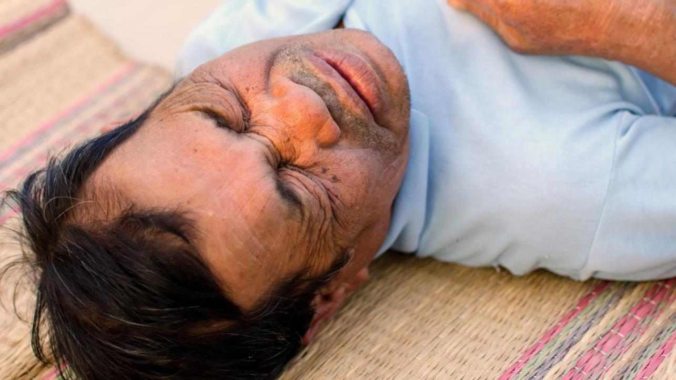
Heat Stroke
Notes:
1) Explain what heat stroke is.
2) Feel free to use the heat stroke example if time allows.
Trainer: We finally arrived to the riskiest of this illness: heat stroke. Remember the first video we saw. Not all the people who suffer of heat stroke die, many may survive, spend some time in the hospital, but they are now more susceptible to heat related illness. Some other suffer brain damage, because blood circulation stop getting oxygen to the brain and suffers permanent damage.
Heat stroke example: In 2017, a person in La Belle, Florida had a heat stroke as severe that now he can’t talk, walk, or know when he has to go to the bathroom; father of four children.

Slide 54
All the above and…
Seizures
Fainting
Red, warm, sweat-free skin
Coma
Death
Notes:
1) State the symptoms of heat stroke.
Trainer: Our body has a limit, and when we suffer a heat stroke our body’s heat-regulating system is overwhelmed by excessive heat; our body by itself is not going to cooldown. Our core temperature has got above 40o C and the symptoms include:
All the previous symptoms, remember the cascade effect, plus
■ Convulsions
■ Fainting
■ Red, hot and dry skin.
■ May result in coma or even death

Slide 55
Notes:
Point out the immediate medical assistance – CALL 911!

Slide 56
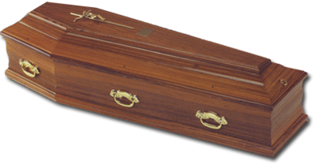
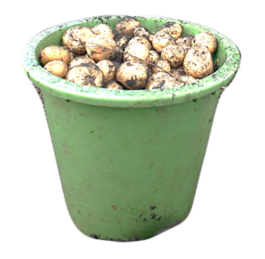
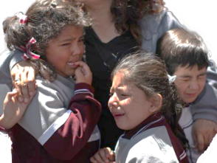
What is a life worth?
$3,800
Notes:
Transition: Let’s have a reality check. We know that a lot of workers purposefully don’t drink a lot of water during the work day. We know that they don’t want to take water breaks, they don’t want to take bathroom breaks –
1) Ask participants why don’t farmworkers want to drink water during the day or take breaks? Wait for participants to respond.
Script: Some of these cultural or personal beliefs may lead to the person taking risky behaviors, increasing the risk for heat-related illness.
*Notes to facilitator:
The following are beliefs that people might have.
“I’m tough, I don’t need a water break”
“I’m not thirsty~ I don’t need a drink”
“I’ll lose pay if take a water break”
“I’ll be letting my team down”
Have you heard anyone saying that?
“I’m new here~ I need to prove myself”
“The crew leader is going to get mad”
The crew leader might say:
“We’re going to take a break in a little while”
“I am going to lost weigh by sweating”
2) Compare the importance of family and life to money
Script: It is important for people not to fall for these beliefs. All we ultimately want is for farmworkers to be healthy and drink water which is the most important way of staying hydrated and preventing heat-illness.
You really think that the extra cents for a bucket worth leaving your family behind.
We all have to provide for our families, but we want to do it in the long run, not just for a few time at the cost of our own health.

Slide 57
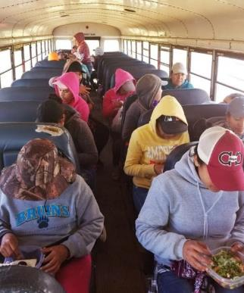
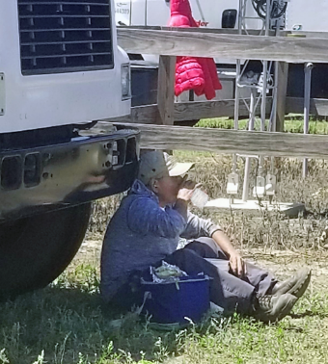
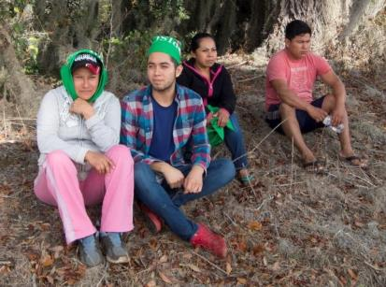
Notes:
1) Summarize the key takeaways of the training. Be sure to discuss the following points.
Anyone can be affected by heat-related illnesses. But heat-related illness are PREVENTABLE! You do not have to die by heat if you take action.
It is agricultural workers who are most at risk of heat-related illnesses. To the point of being the occupation with the highest number of heat deaths.
The risk of suffering a heat-related illness is because agricultural workers sweat a lot and become dehydrated. Lack of water causes heat-related illnesses.
Our body is mostly water, and when we lose water, or we begin to dehydrate, affects all the systems of our body.
Heat-related diseases are progressive diseases, the symptoms can be easily identified and therefore can be prevented.
Workers who have just arrived in the region, new workers and workers with certain health conditions are at greater risk of heat-related illnesses.
Drinking water regularly - a glass of water every hour - is the most important thing you can do to prevent heat stress.
Avoid caffeinated and alcoholic beverages during work because they will lose water and dehydrate.
High fat foods and sugary drinks during the workday increase body heat and impede their ability to cool the body.
Light colored clothing and breathing material helps cool your body.

Slide 58
This curriculum would not have been possible without the helpful contributions of (in alphabetical order): Fiorella Chavez Carlos, Fernanda Correa, Jeannie Economos, & Guojuan Shang.
Suggested Citation: Tovar Aguilar, A., Marin, A.J., Hopewell, J., Trejo, M., Garcia Rendon, M., Ordaz Gudino, C. & Grzywacz, J.G. (2018). Enfermedades Relacionadas al Calor[Kit]. Tallahassee, FL: Florida State University.
This curriculum was made possible by a grant from the National Institute for Occupational Safety and Health (U54-OH011230). The Curriculum follows the requirements of the revised Worker Protection Standards of the United States Environmental Protection Agency, but the content, images, and facilitators’ guide are the authors’.

